Slide 1
Bot Framework Workshop

Slide 2

Agenda
Bot Framework Overview
Setup Installs Basic Bots
Understanding Dialogs
Form Flow
Carousels Cards and Adaptive Cards
Intent Dialogs – Natural Language Processing
Cognitive Services
Channels and Publising
Extras

Slide 3
Technology Needed today Node
Installs
Ngrok
GIT (not necessary but helpful)
Visual Studio 2015 & Bot Template (for C#)
Signups needed
MSID
BotFramework.com
LUIS – Language Understanding Intelligent Services

Slide 4
Understanding the Bot Framework

Slide 5
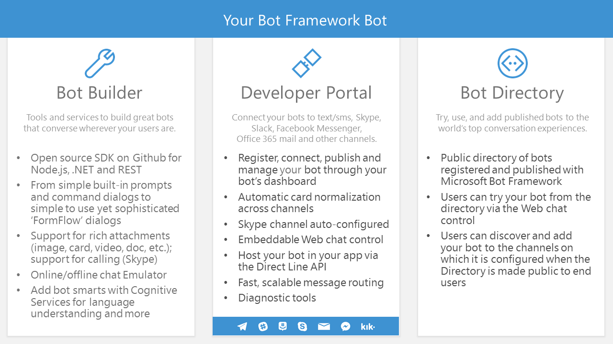

Slide 6
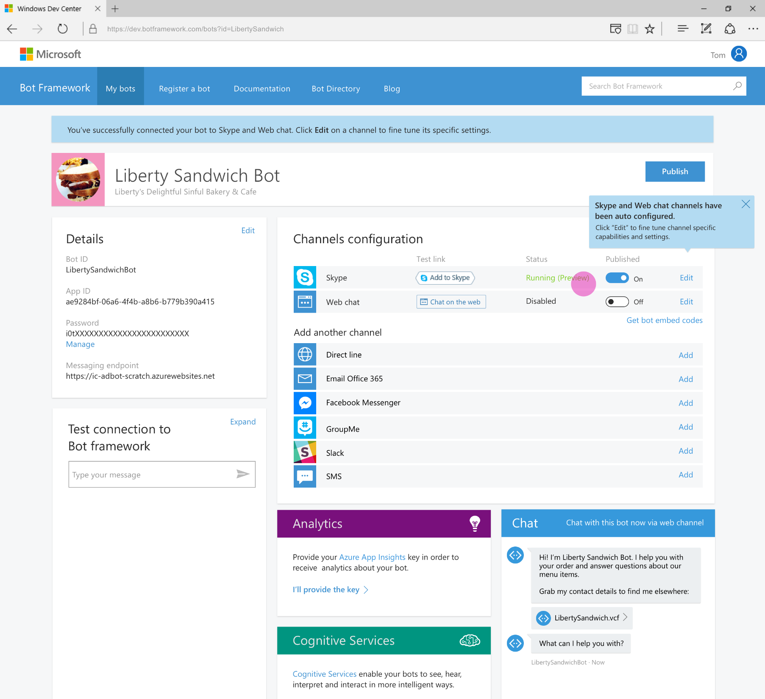
Developer Portal
Register your bot
Connect to channels
Test
Publish
Manage
Measure

Slide 7
Build a bot with a clear purpose
Only choose technologies and APIs that clearly serve that purpose. Focus every design decision into driving that goal.

Slide 8
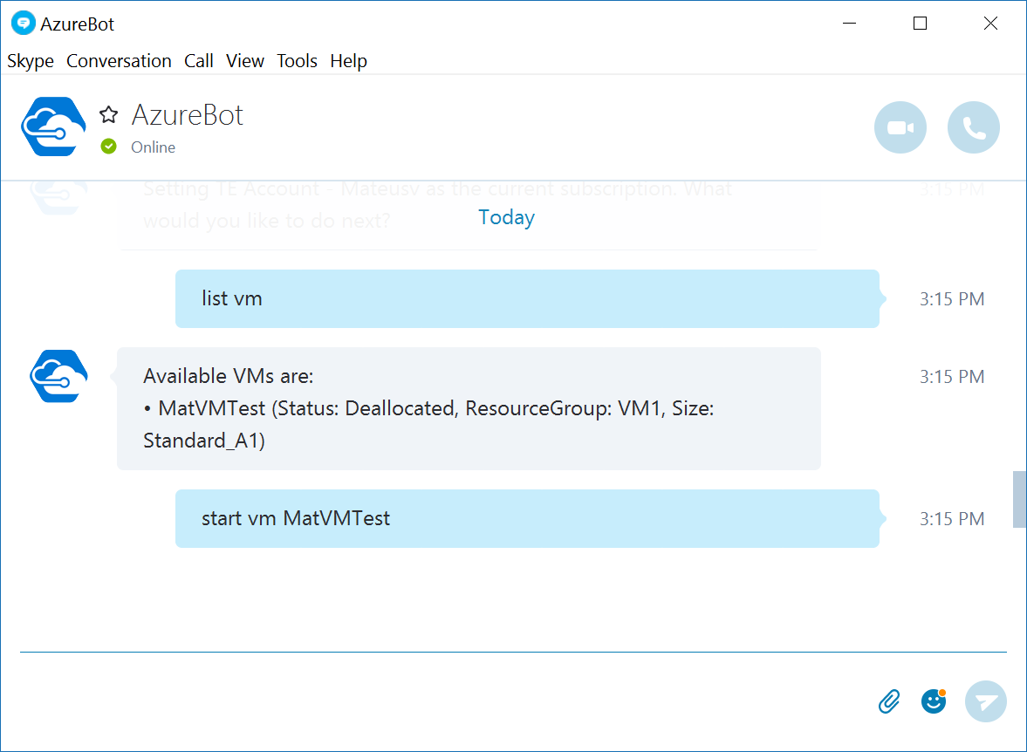
AzureBot: Manage your cloud from Skype
Start from the desktop, list your VMs, start a VM
(it all takes 5 seconds!)

Slide 9
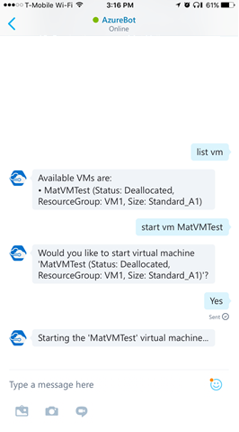
AzureBot: Manage your cloud from Skype
Switch to your phone, confirm you want to star the VM, receive the notification when done.
-No logon required
-No app sync required
-Woks across all your devices and web
It. Just. Works.
github.com/microsoft/azurebot

Slide 10
Bots improve workflows

Slide 11
Call centers/help desk/customer service
Every company deals with this:
First triage/data collection
Simple and repetitive solutions
Customer call
Complex cases and escalation

Slide 12
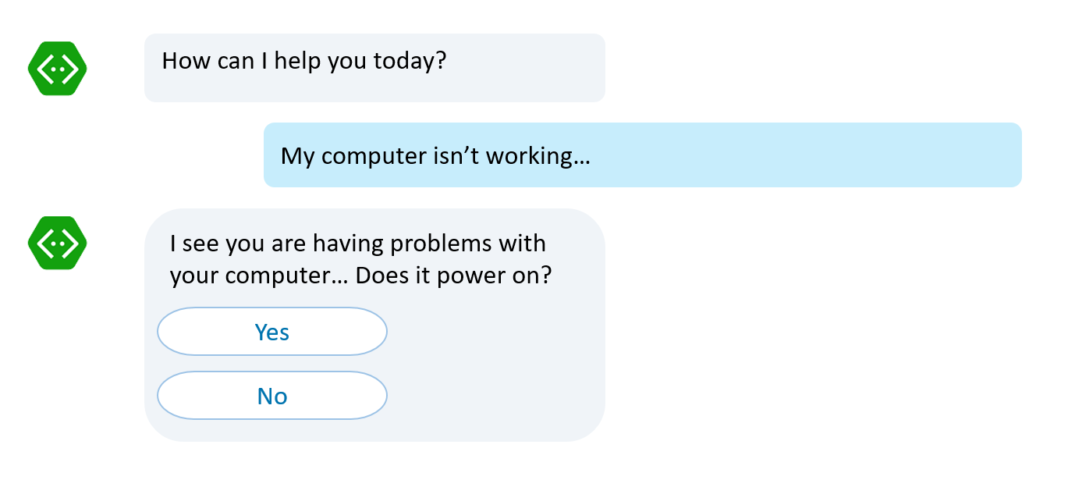
Call centers/help desk/customer service
Every company deals with this:
First triage/data collection
Simple and repetitive solutions
Customer call
No waiting in line to be helped Bots handle it
Complex cases and escalation

Slide 13
Call centers/help desk/customer service
Every company deals with this:
If it is simple and repetitive, it can be coded. Bots can accelerate it
First triage/data collection
Simple and repetitive solutions
Customer call
Complex cases and escalation

Slide 14
Call centers/help desk/customer service
Bot to human hand off: Complete or supervised
Complex cases and escalation

Slide 15

Call centers/help desk/customer service
Complete bot to human hand off
Thank you for providing all this information. I have John with me now who will take from here and help you out
Hello, this is John. I understand your computer won’t power on. Let’s take a look at some service options

Slide 16
Call centers/help desk/customer service
Supervised bot to human hand off
I’ve tried these steps, my computer still won’t turn on
Note to operator: It sounds like the user will need hardware replacement, what next step should I take?
Apologize to user
Suggest hardware service
Let me type
I suggest us to request a hardware service. We can have one of our service engineers look at your computer
Sounds lovely, thank you

Slide 17
Bot Facts

Slide 18
Fact #1: Users love buttons
When given the choice of rich controls, text and voice, user will choose:
UI Controls first
Text second
Voice third, only if options above aren’t possible (e.g. Driving a car)

Slide 19
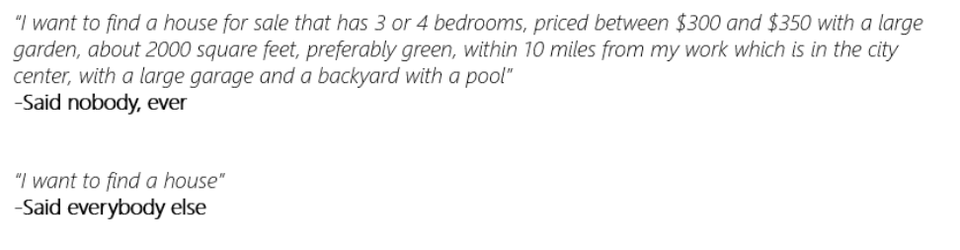
Fact #2: Users never say things the way you expect
As you model your NLP, make sure you’re being realistic

Slide 20
Fact #3: Search can do wonders for bots
QnAMaker.ai:
Super low friction way of creating a Q&A bot
Built in web and document crawler: Parses data and builds the QnA easily
Not great for too many records
Not great for deep level customization of the experience
Azure Search:
Can work with millions of records like a breeze
Works with different document formats and data sources
Takes more effort to prepare/code/fine-tune

Slide 21
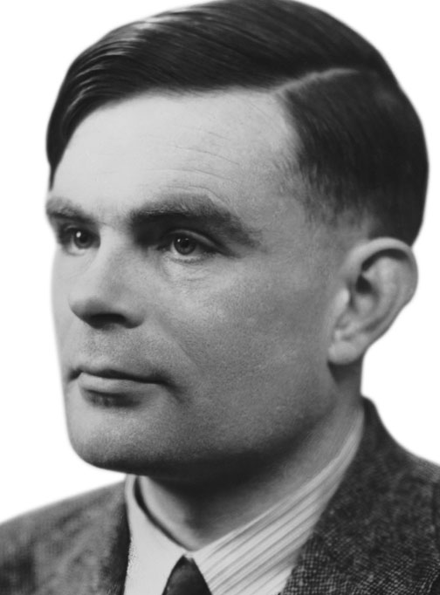
Fact #4: Not all bots need to have conversations
Sometimes buttons do everything you need.
Avoid the engineer’s urge to complicate simple things
Your business requirement is NOT to pass the Turing Test: It is to solve your user’s problem!

Slide 22
An x-ray of a typical bot
Conversation Canvas/Channels
Your code goes here
Web Chat
Bot Connector Service
Email
Message input <> output
State Management
Facebook
GroupMe
Your bot code
API, SDK calls
Kik
Skype
Bot Builder SDK
Slack
+ Microsoft Cognitive Services
Telegram
Other services, APIs,
Databases, Azure Machine Learning, Azure Search, etc…
Natural Language
Translation
Vision/Face
Emotion
Twilio (SMS)
…
Direct Line…
Speech
Entity Extraction
Search
Knowledge API
…
…
…

Slide 23














Bot Communication
User
Channel
Bot

Slide 24
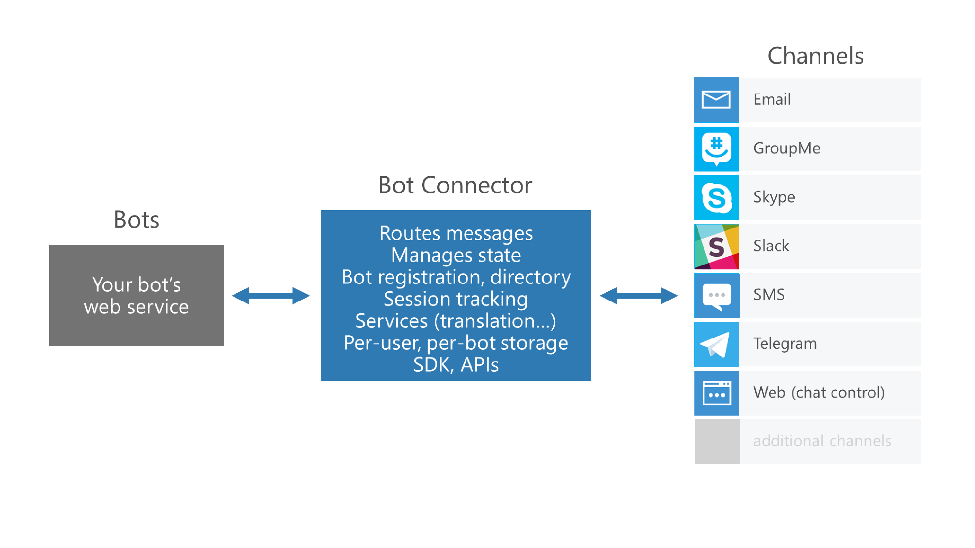

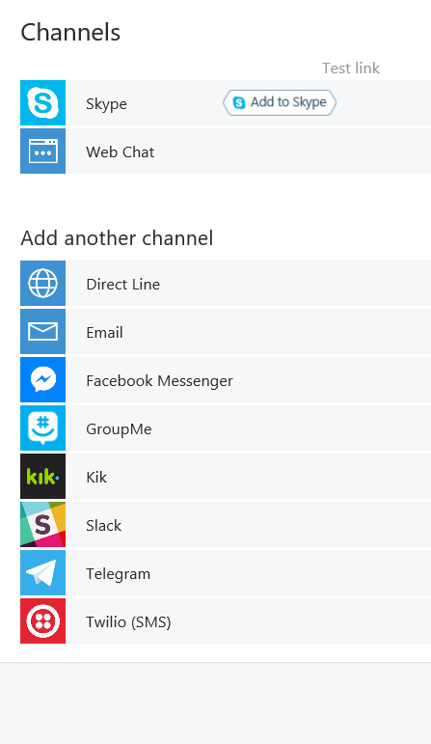

Slide 25



Connector Service
Connector Service
Bot
Channel
Activity JSON
Channel JSON

Slide 26
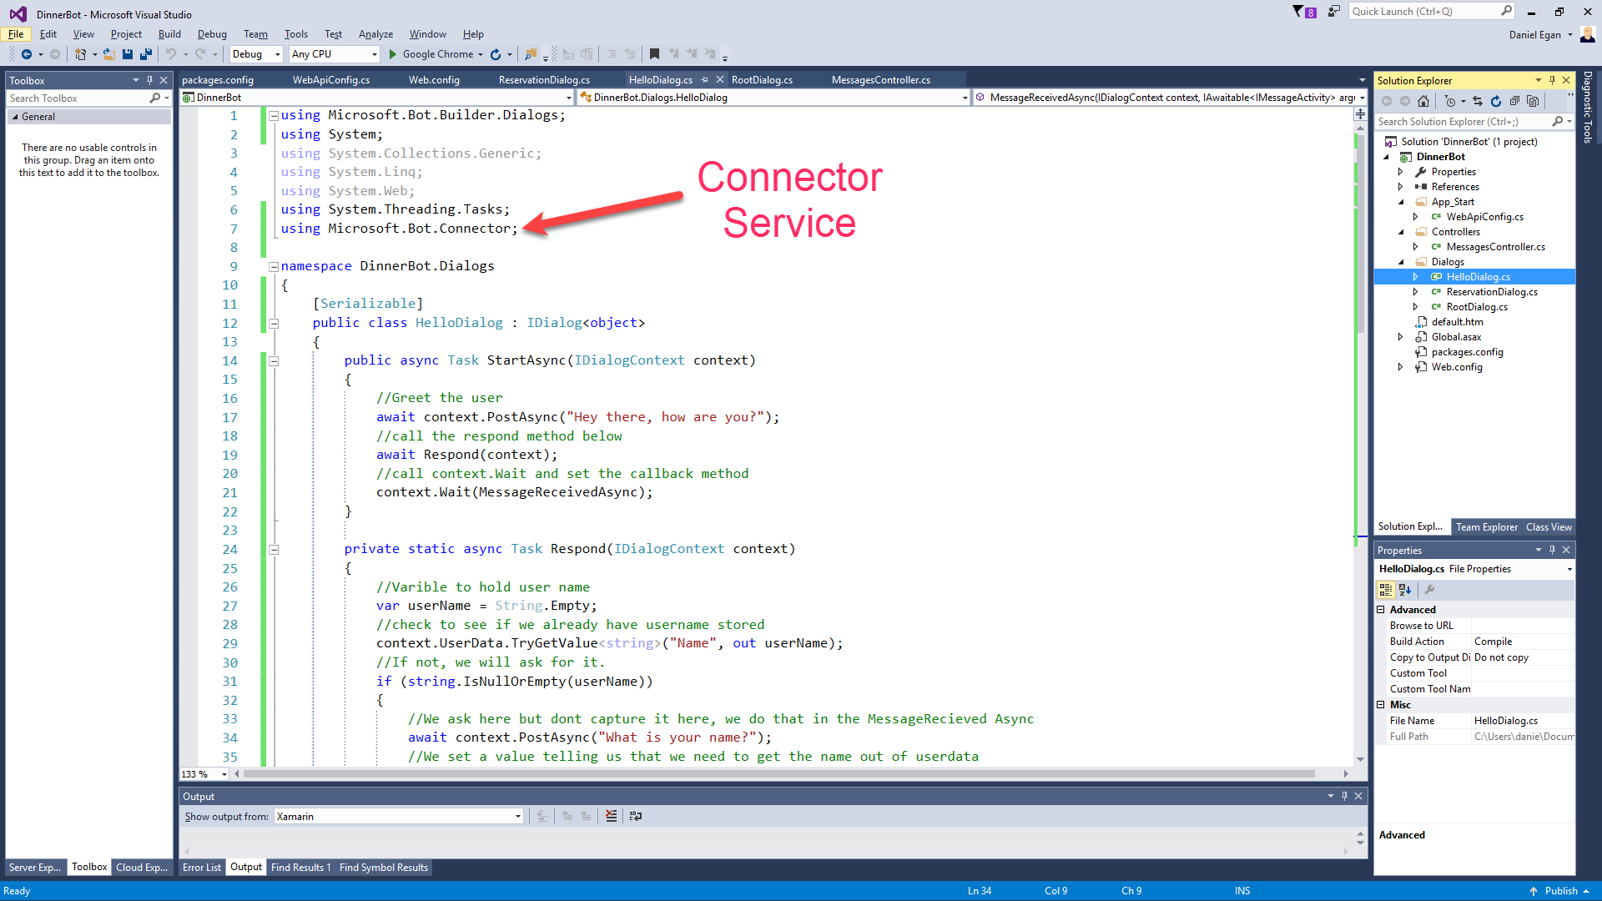

Slide 27
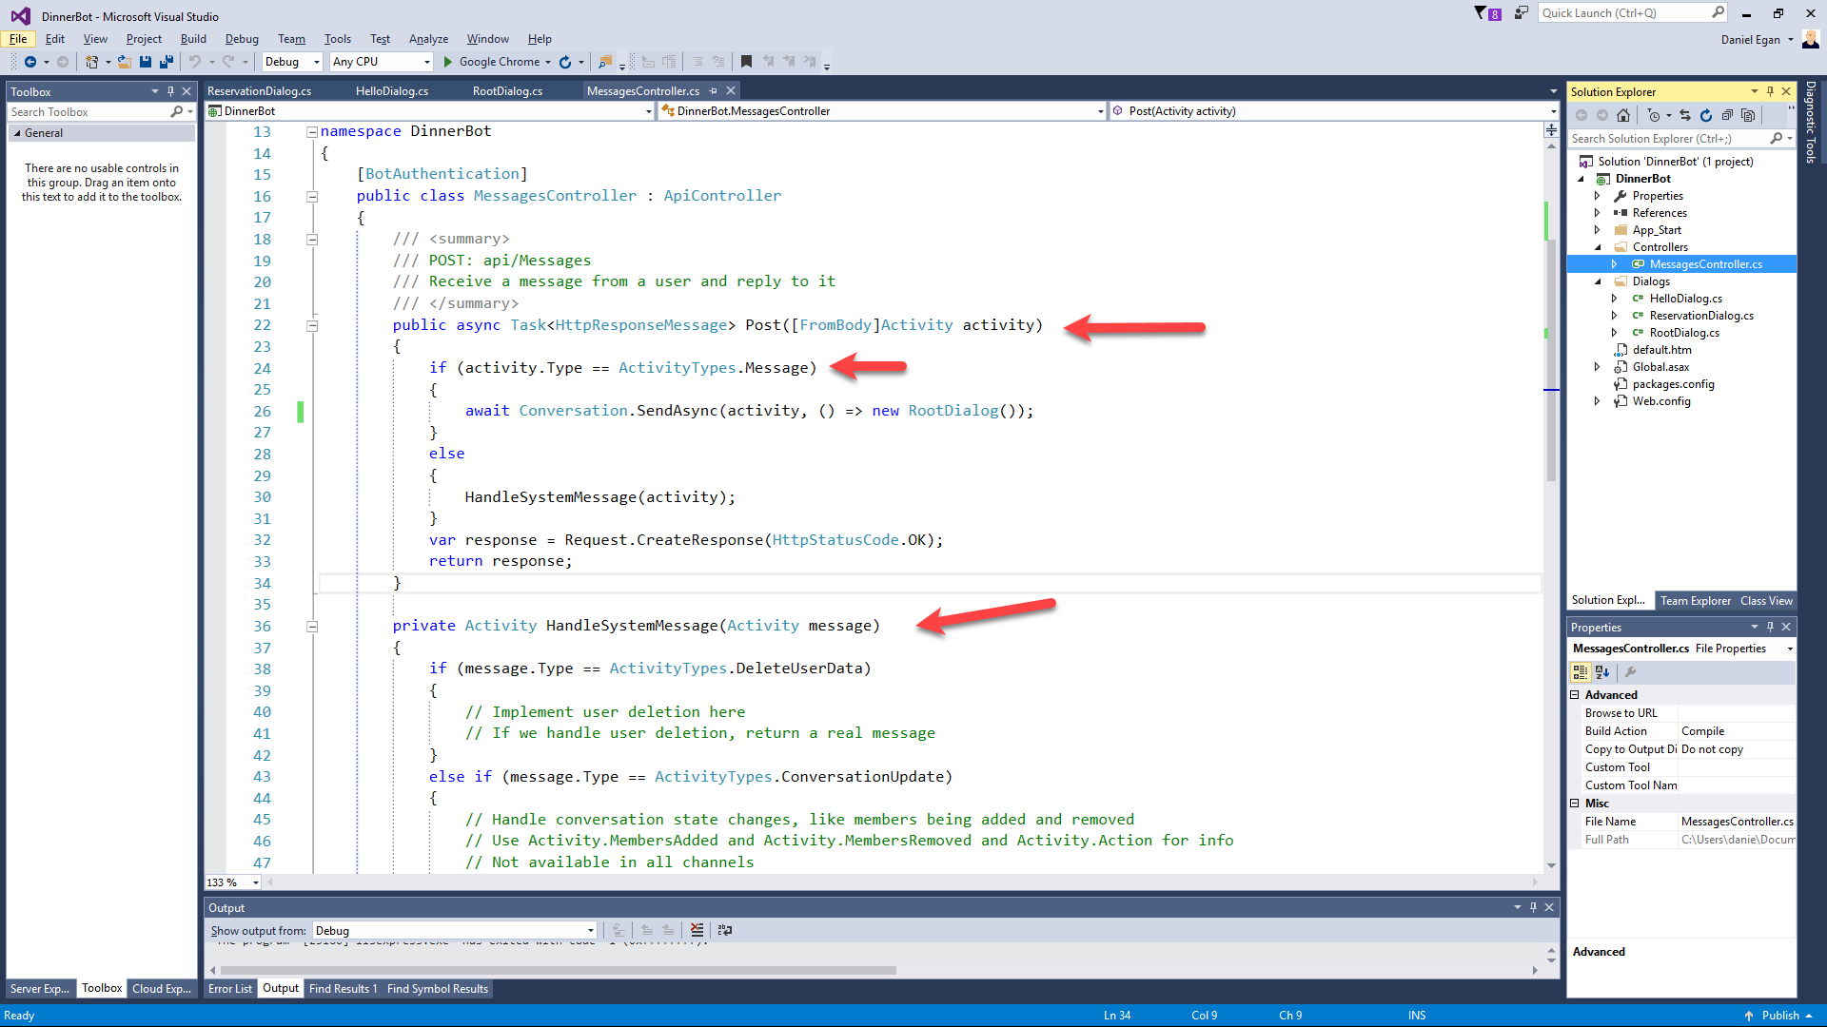

Slide 28
Understanding Dialogs

Slide 29

Dialogs
User
Bot
Hi
Hi I'm Dinner Bot how can I help you today?
I would like to reserve a table.
Great, lets get started.

Slide 30
Dialogs = Routing
Hi
How can I help you
I want to reserve a table
Do we know the user?
No
Yes
GetUserInfoDialog
ReservationDialog

Slide 31
Dialog Chain
Conversation
Introduction Dialog
User Info Dialog
Reservation Dialog
C# Chaining or Context.Call
node beginDialog/endDialog or waterfall

Slide 32
Persisting Data
userData
stores information globally for the user across all conversations.
conversationData
stores information globally for a single conversation. This data is visible to everyone within the conversation so care should be used to what’s stored there. It’s disabled by default and needs to be enabled using the bots persistConversationData setting.
privateConversationData
stores information globally for a single conversation but its private data for the current user. This data spans all dialogs so it’s useful for storing temporary state that you want cleaned up when the conversation ends.
dialogData
persists information for a single dialog instance. This is essential for storing temporary information in between the steps of a waterfall.

Slide 33
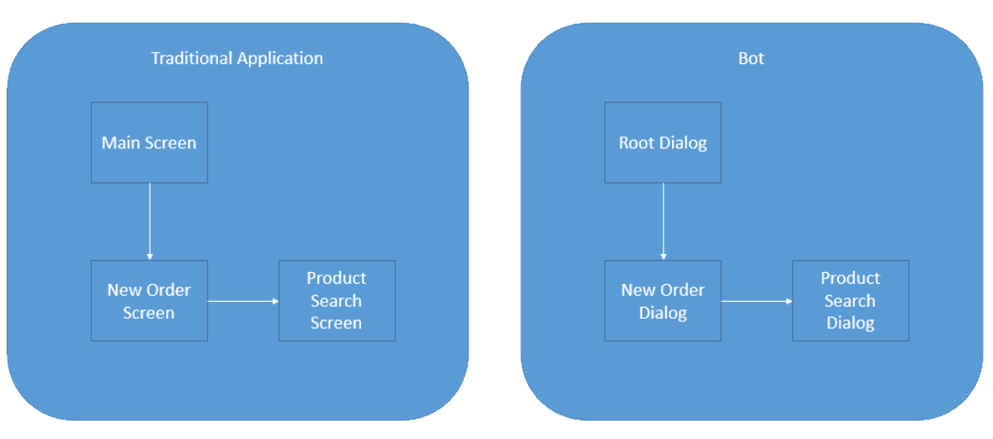
Dialogs are for bots like screens are for apps
They separate concerns and organize flows, exactly the same way:

Slide 34
Dialogs are serialized into stacks
This is how we know how to navigate “back”
Users won’t necessarily think that way
…
Dialog 2
Dialog 1
Root Dialog

Slide 35
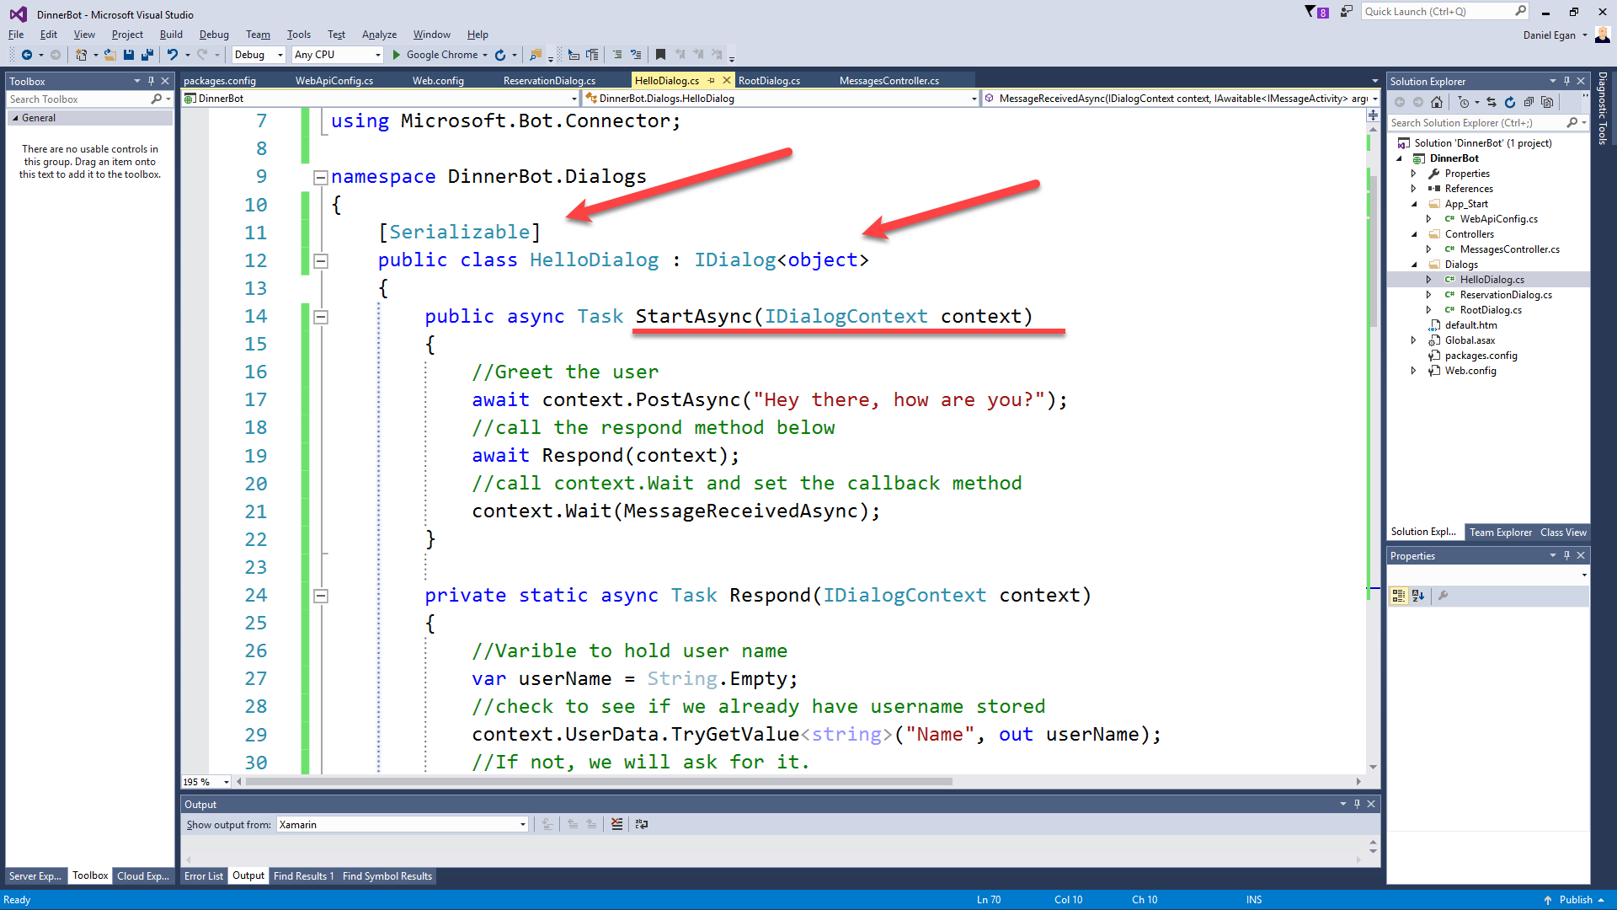

Slide 36
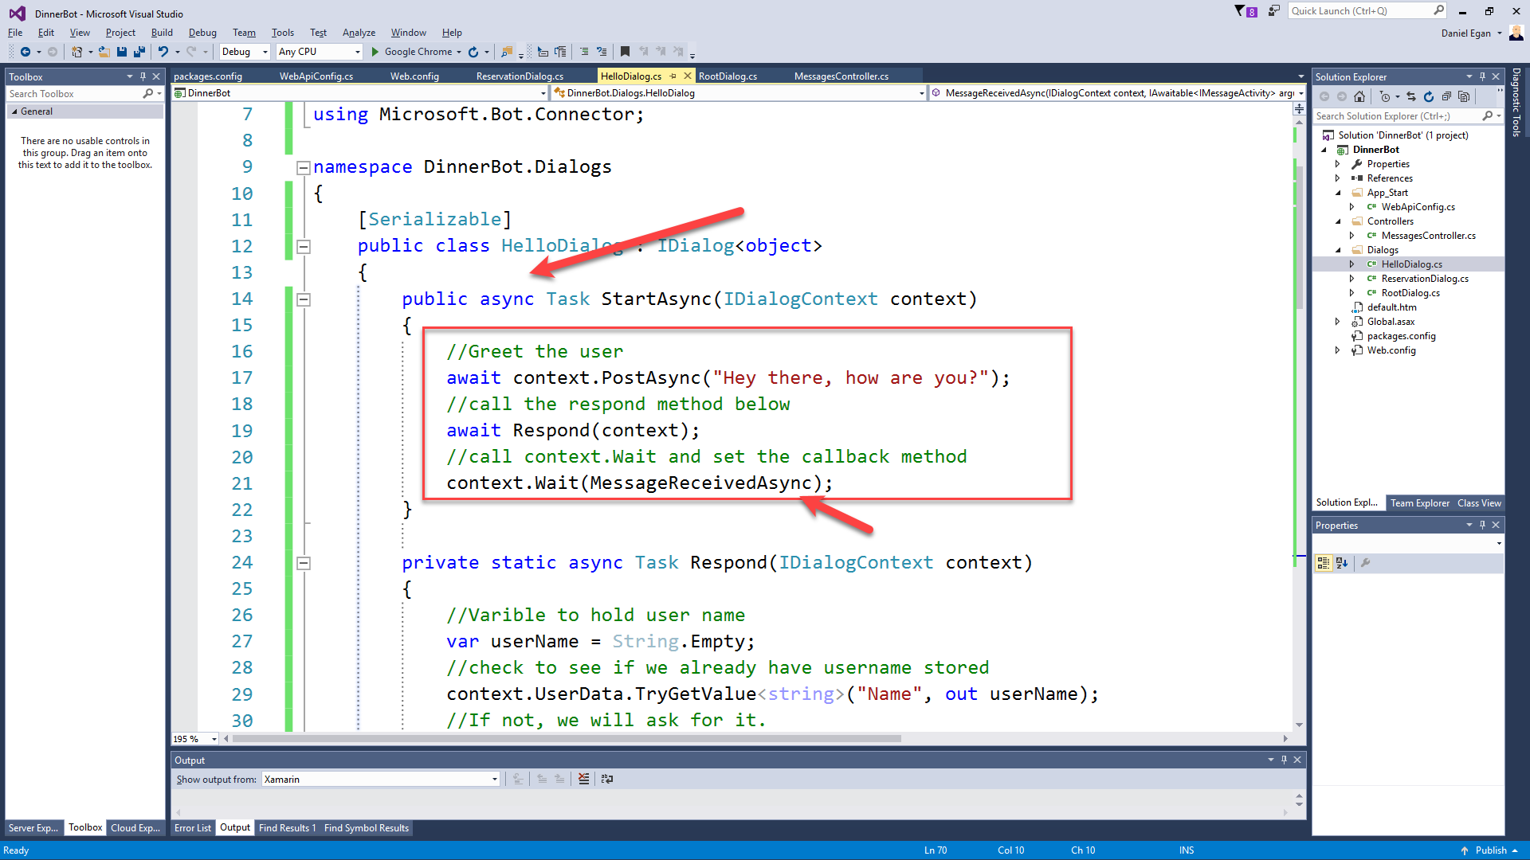

Slide 37
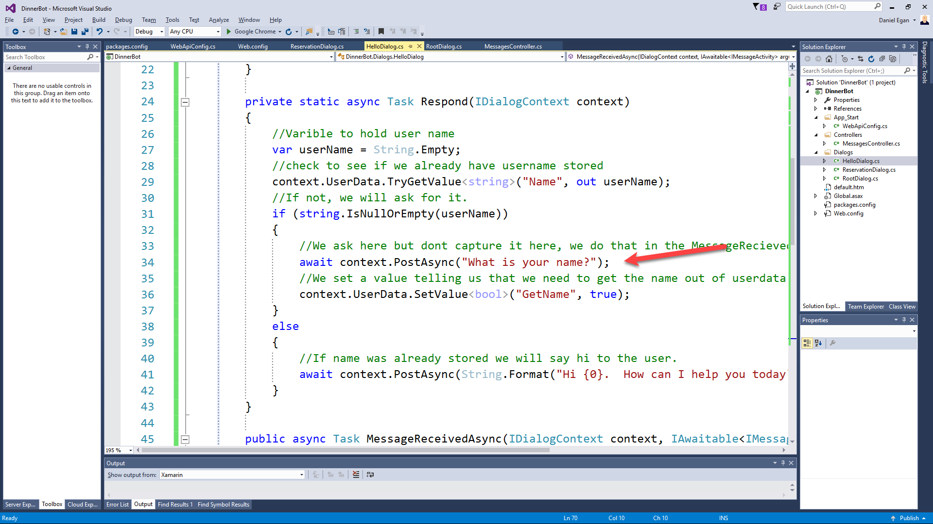

Slide 38
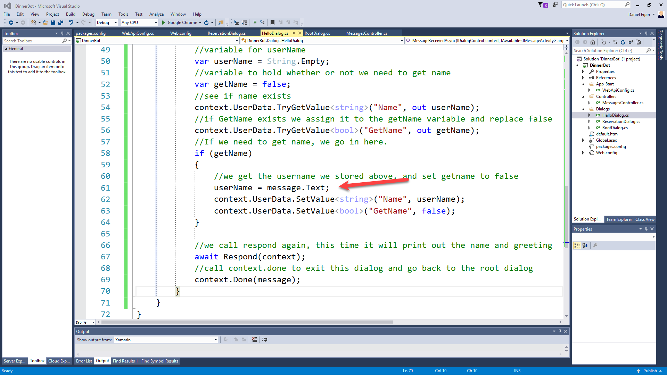

Slide 39
Hands On LAB
Exercise 1 – Basic Bot Builder & Exercise 2 – Creating Dialogs

Slide 40
Form Flow

Slide 41
Form Flow
(*** only in C# SDK)
What Date would you like reservations for?
User
Bot
12/14/17
For how many people?
4
What time?

Slide 42
Form Flow
(*** only in C# SDK)
What Date would you like reservations for?
User
Bot
12/14/17
For how many people?
Wait I mean 2/14/17
?????????

Slide 43
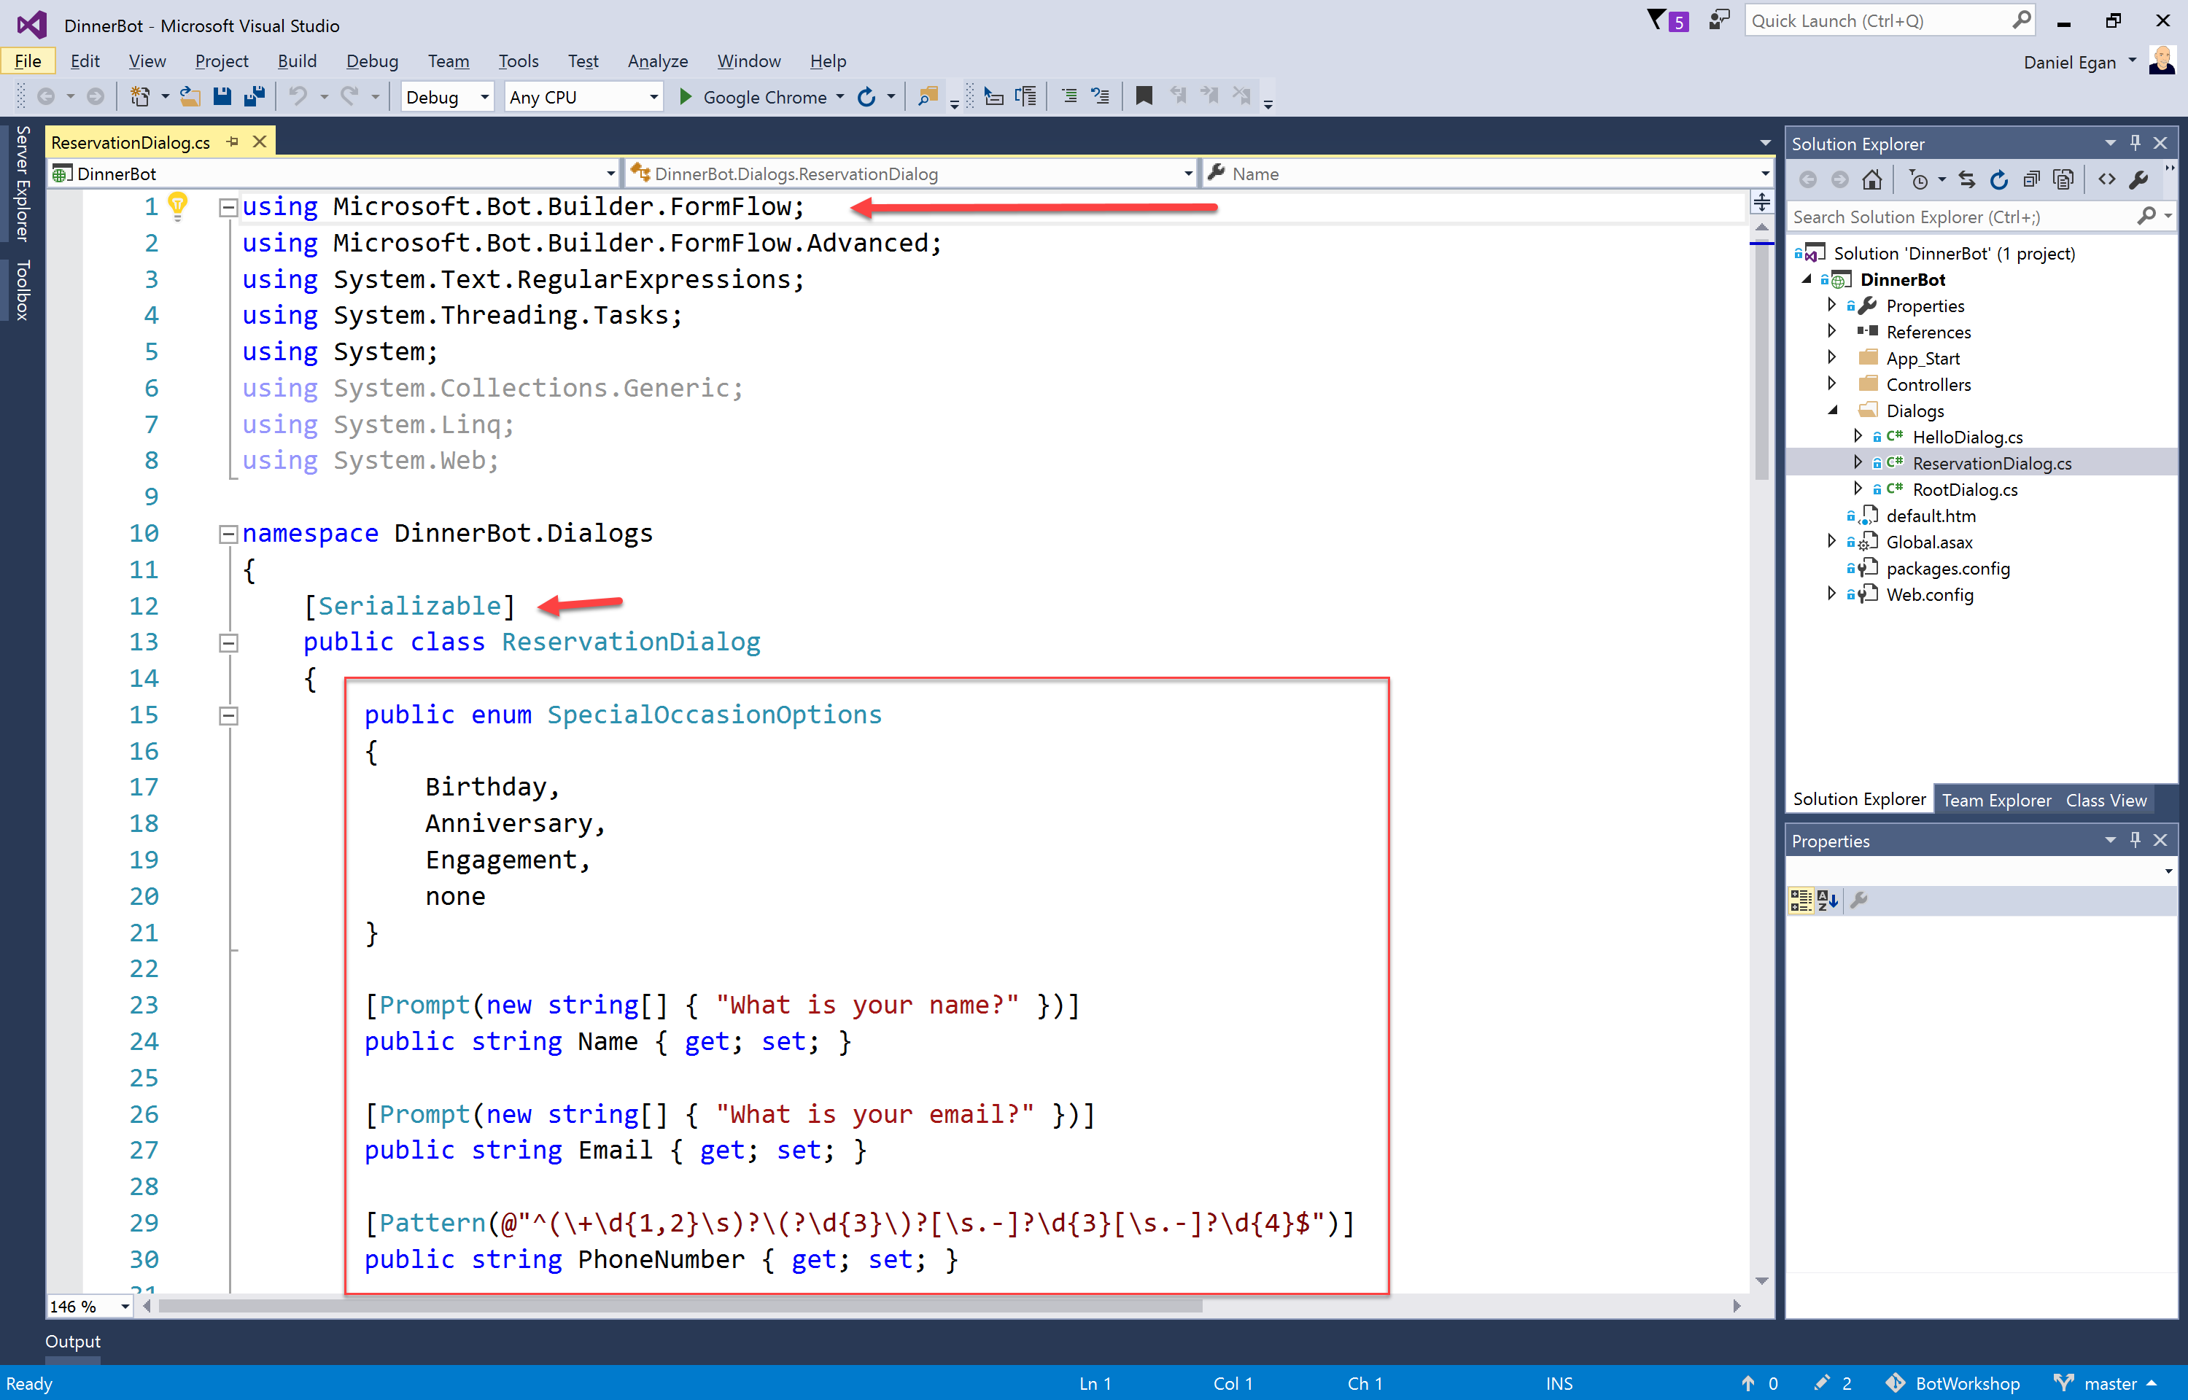

Slide 44
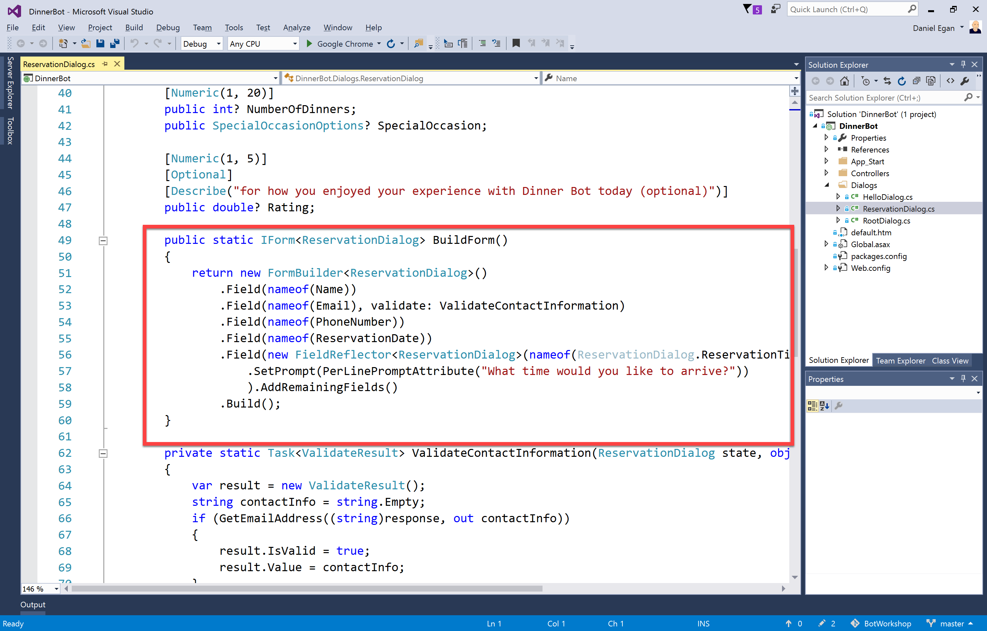

Slide 45
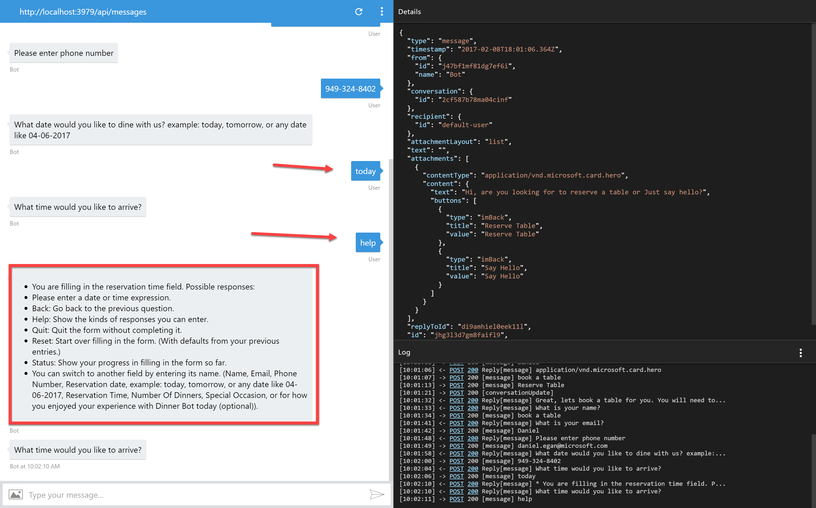
Add slide showing bot handle things.

Slide 46
Hands On LAB
Exercise 3 – Form Flow

Slide 47
Carousels, Cards, and Adaptive

Slide 48
First, let’s talk about Cards

Slide 49
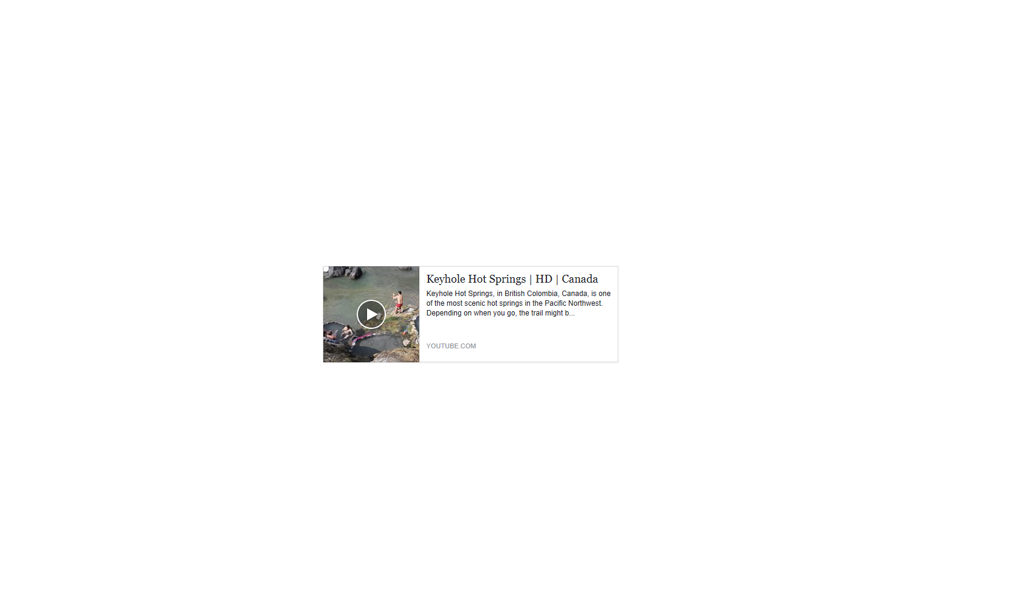
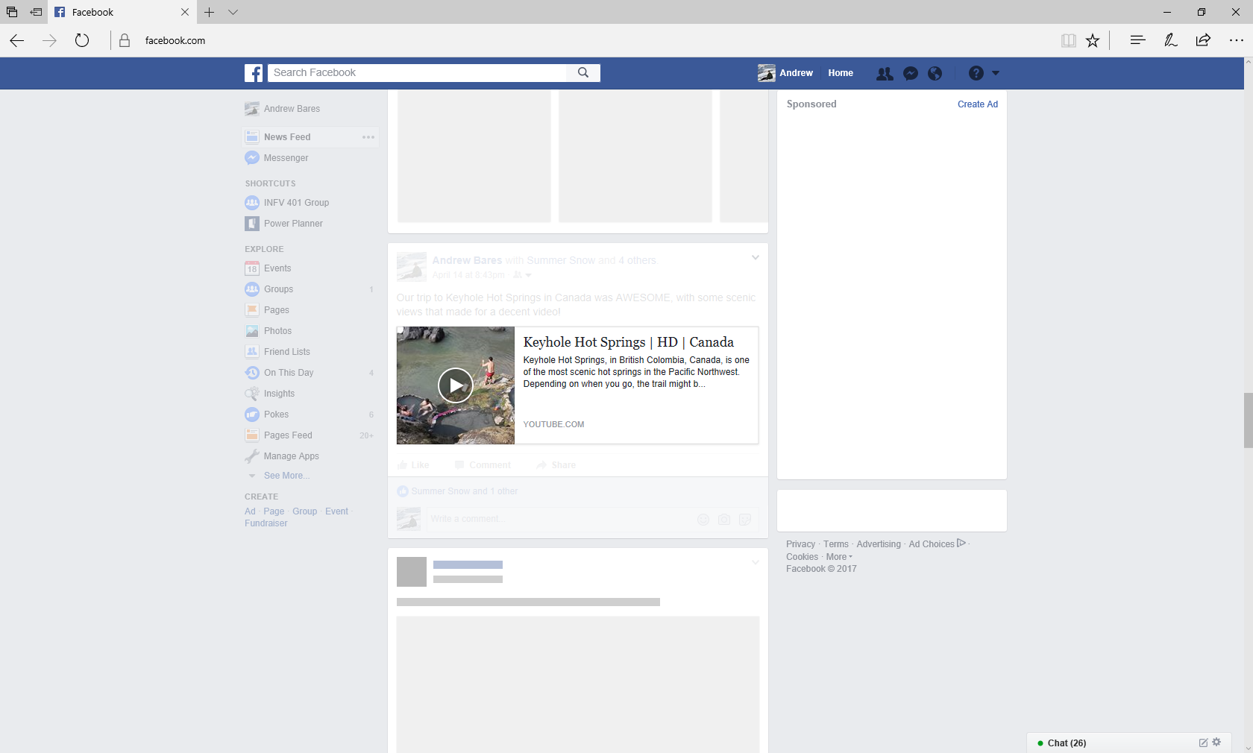
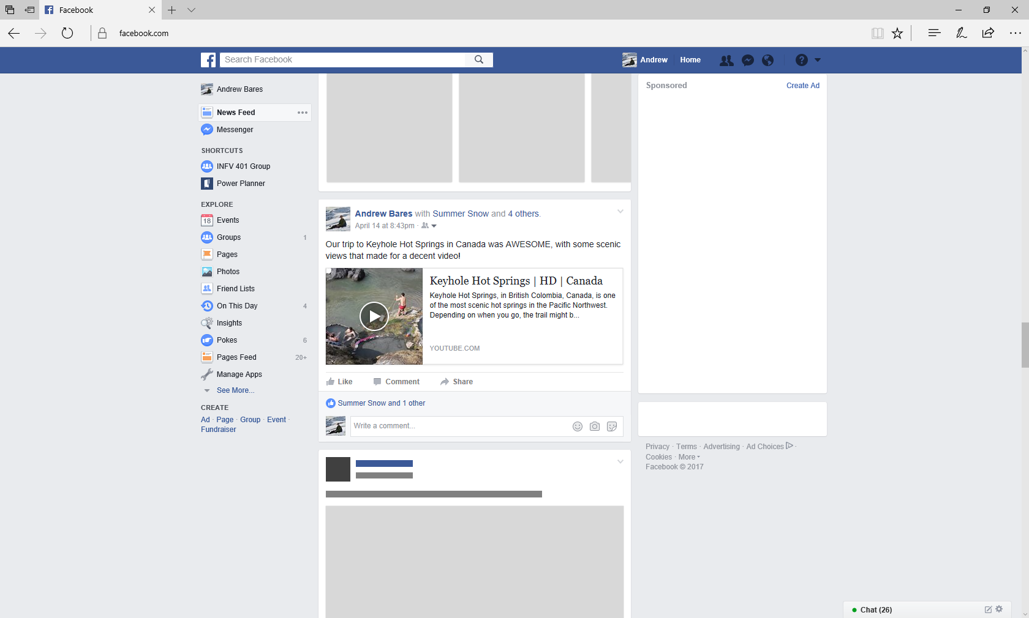
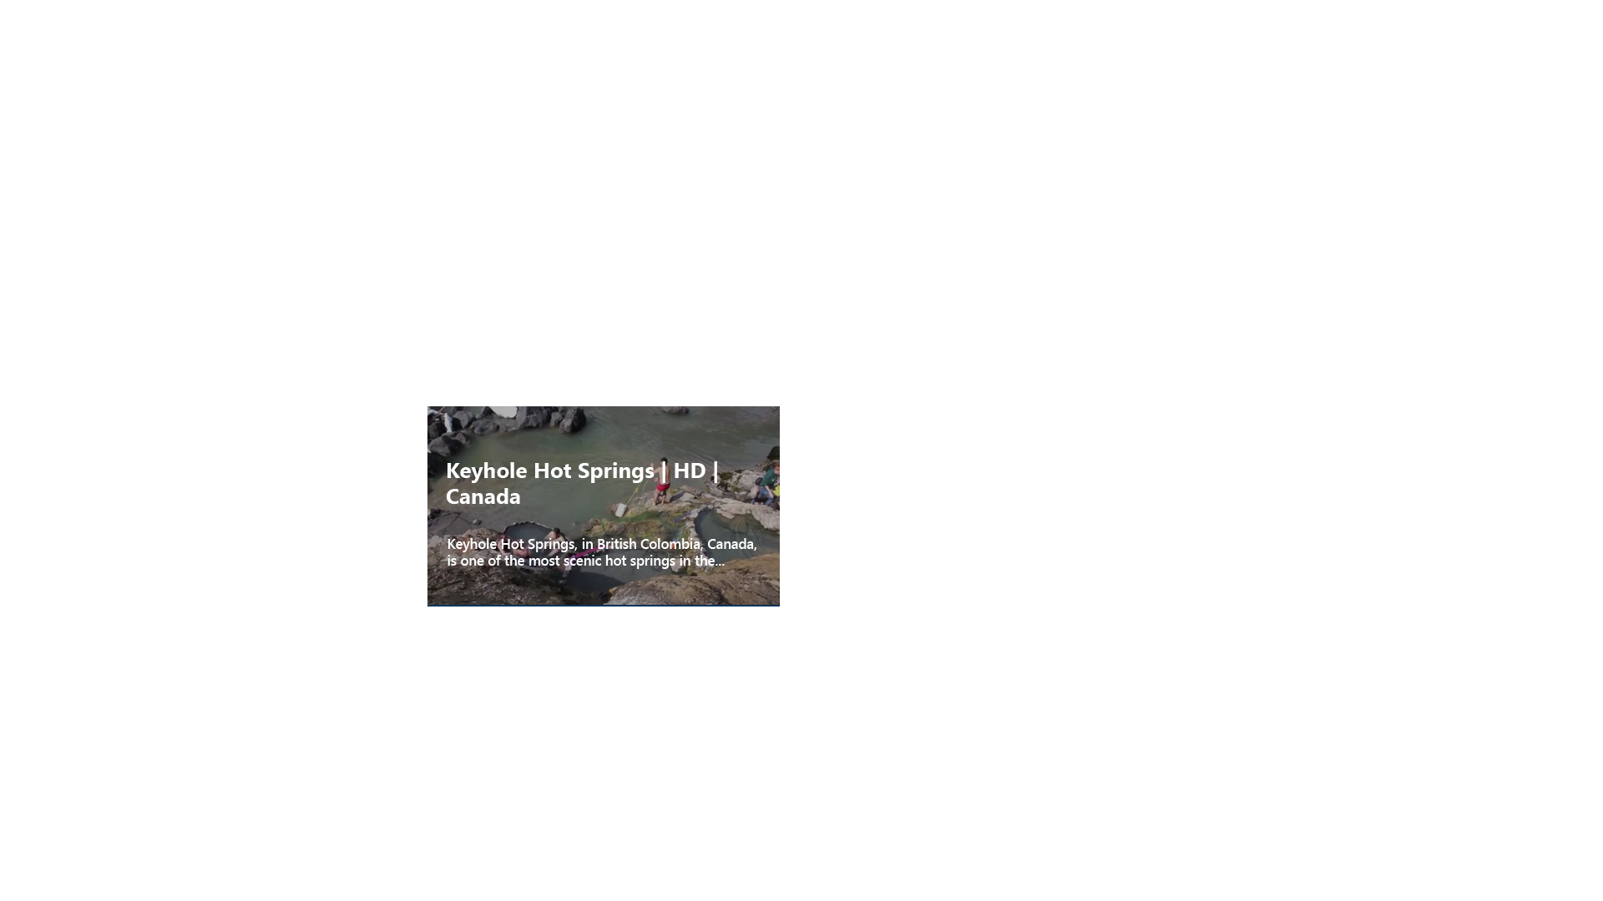
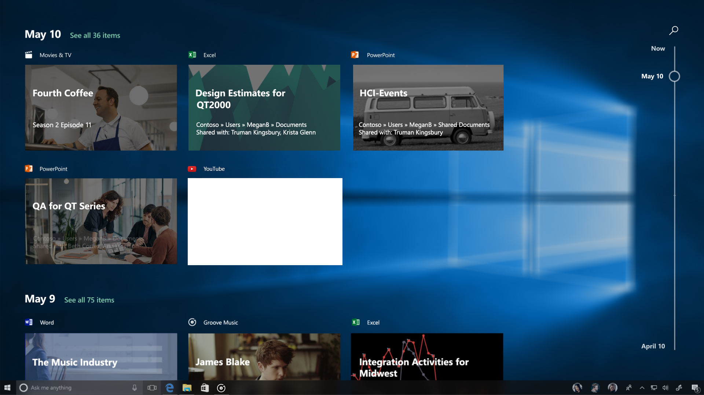
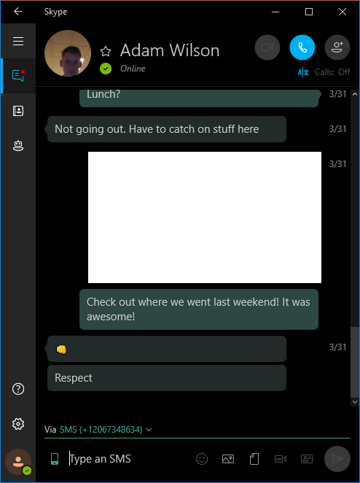
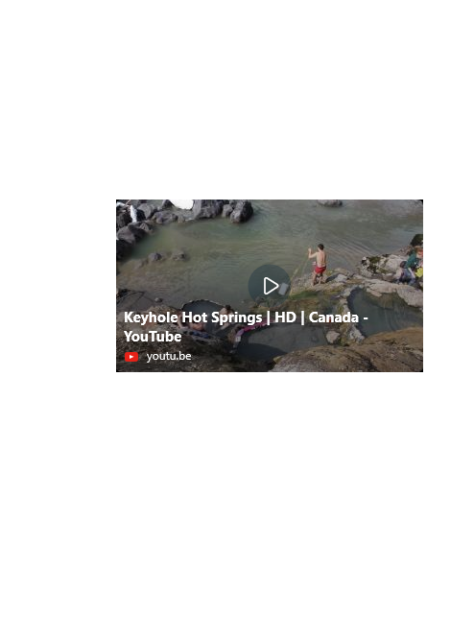
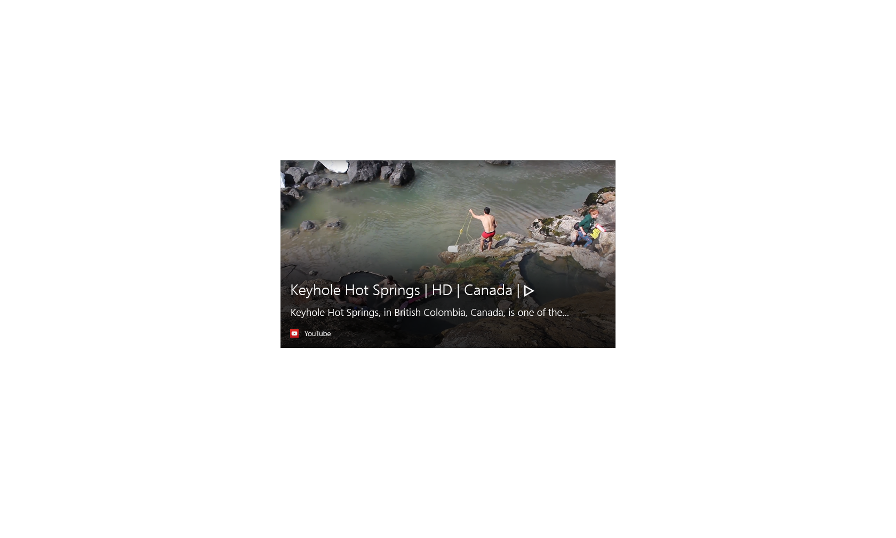
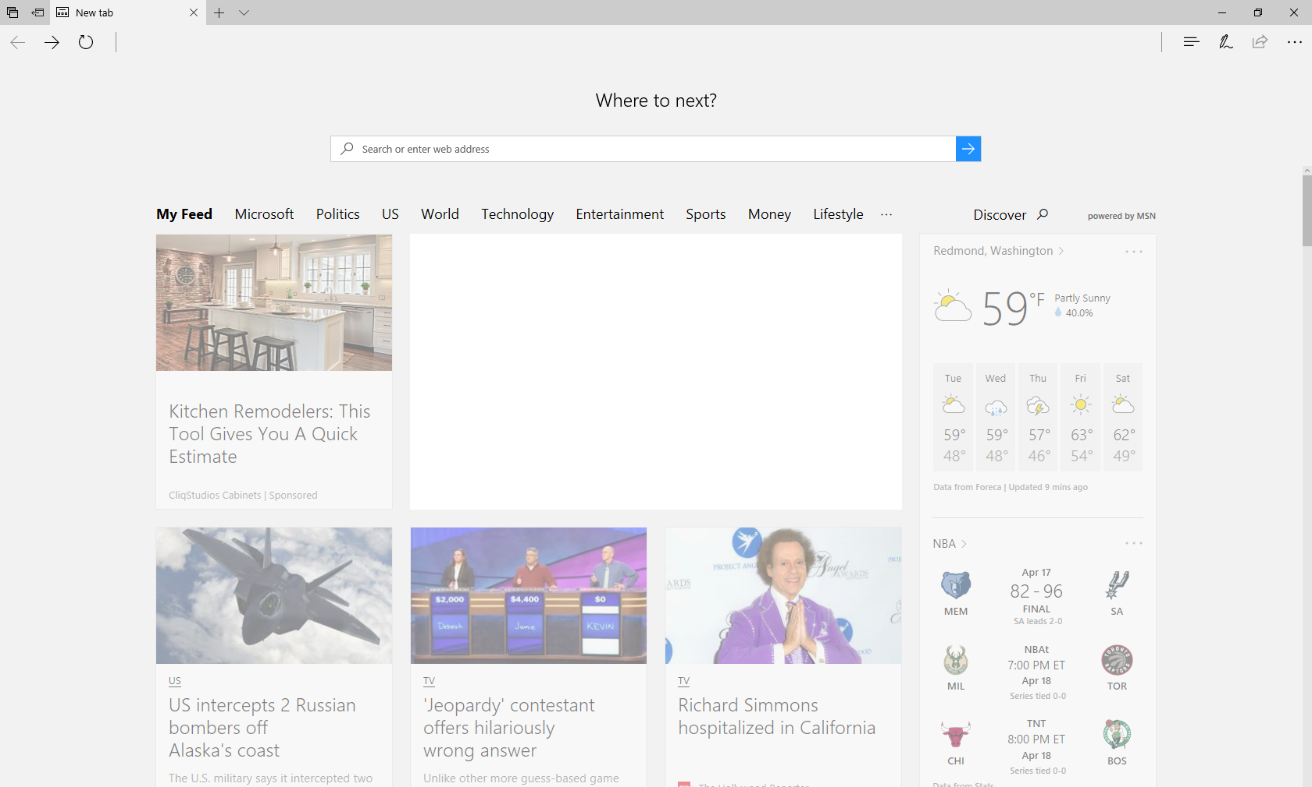

Slide 50
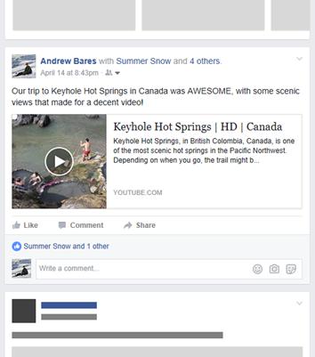
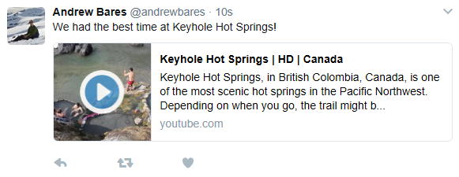
Cards had a humble beginning on social media
Web Pages
Video

Slide 51
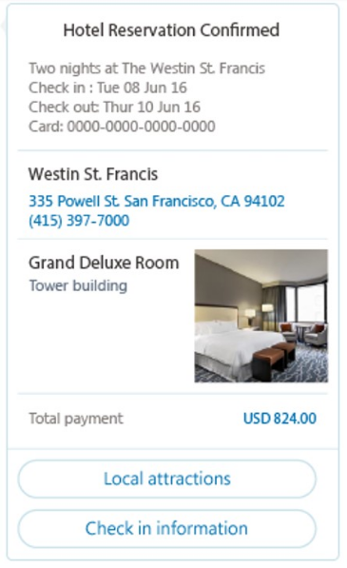
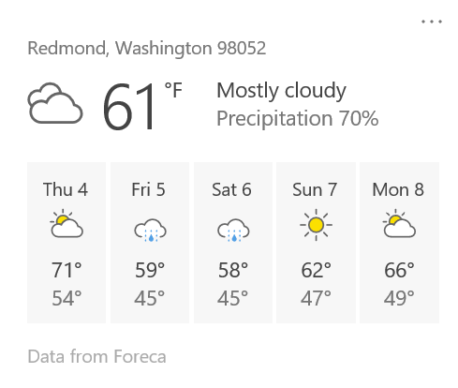
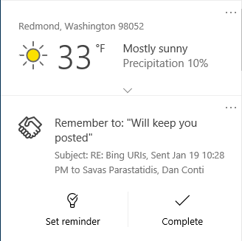
And then…
Weather
Reminders
Reservations

Slide 52
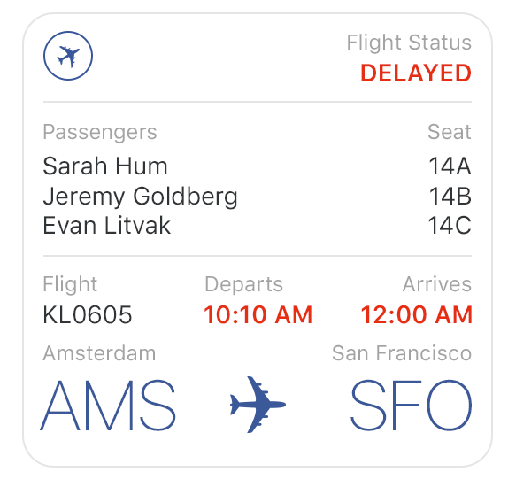
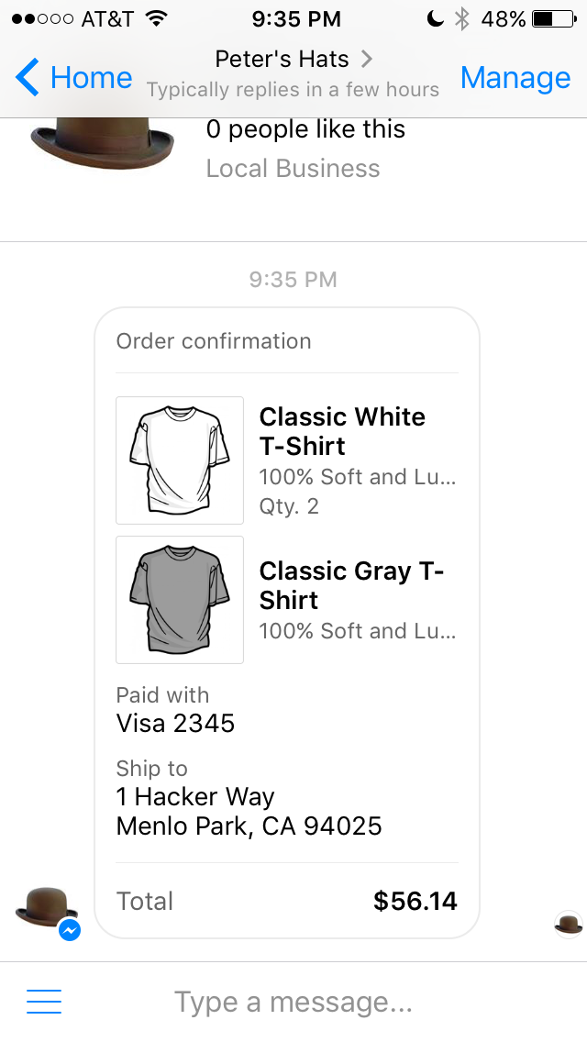
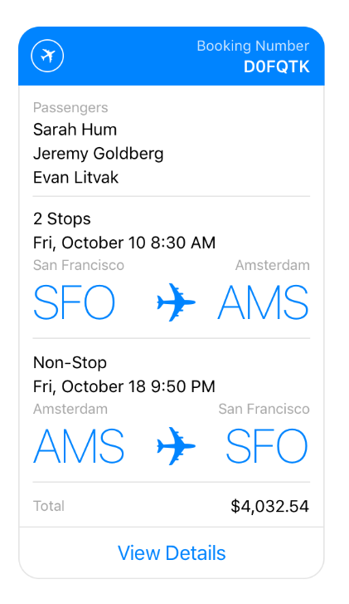
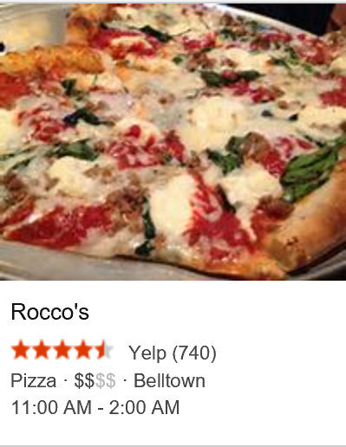
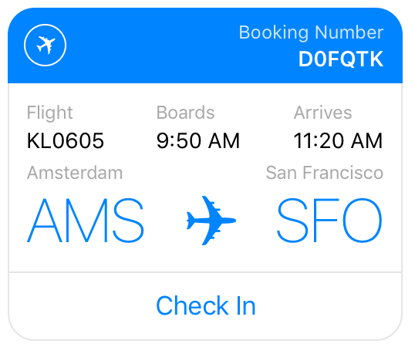
And then…
Airline Flight Update
Restaurants
Airline Itinerary
Receipts
Airline Check-in Reminder

Slide 53
How is this achieved today?

Slide 54
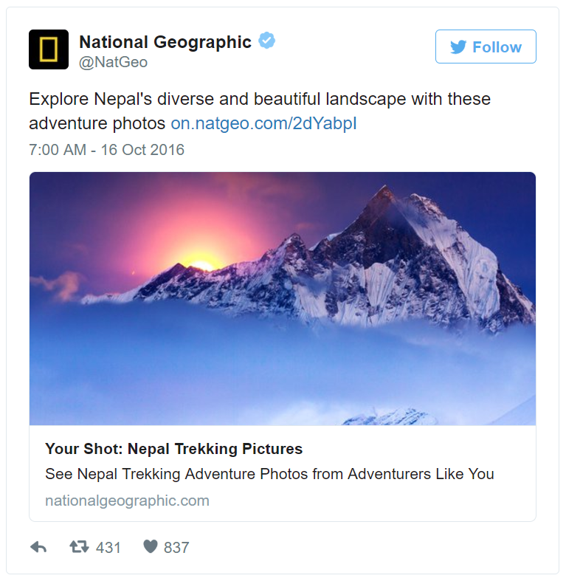
Twitter Cards
<meta name="twitter:card" content="summary_large_image" />
<meta name="twitter:site" content="www.nationalgeographic.com" />
<meta name="twitter:creator" content="@NatGeo" />
<meta name="twitter:title"
content="Your Shot: Nepal Trekking Pictures" />
<meta name="twitter:description"
content="See Nepal Trekking Adventure Photos from
Adventurers Like You" />
<meta name="twitter:image"
content="http://something.com/image.jpg" />

Slide 55
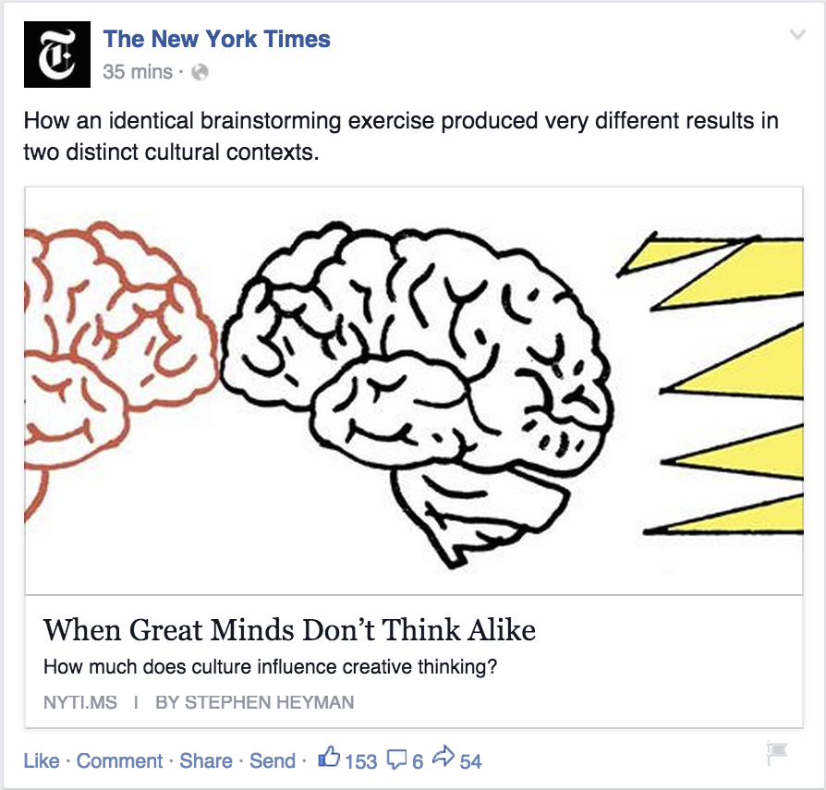
Open Graph
<meta property="og:url" content="article.html" />
<meta property="og:type" content="article" />
<meta property="og:title"
content="When Great Minds Don’t Think Alike" />
<meta property="og:description"
content="How much does culture influence creative thinking?" />
<meta property="og:image"
content="http://nyt.com/summary-image.jpg" />

Slide 56

Facebook Messenger Templates
{
"type": "template",
"payload": {
"template_type": "airline_itinerary",
"passenger_info": [
{
"name": "Sarah Hum"
}
],
"flight_info": [
{
"flight_number": "KL9123",
"departure_airport": {
"airport_code": "SFO",
},
"arrival_airport": {
"airport_code": "AMS",
}
}
],
"base_price": "12206",
"tax": "200",
"total_price": "14003“ }
}
Notes:
All airlines get the same card.

Slide 57
Benefits of templates
For Host Apps
For Users
For Content Authors
All 3rd party content is tightly controlled
Facebook looks like Facebook
Twitter looks like Twitter
Only have to decorate their content once

Slide 58
Challenges with templates
For Host Apps
For Content Authors
Every template must be designed, implemented, and documented on every platform
News Articles
Limited types of content (articles, video, airline, etc.)
No ability to customize the templates

Slide 59
Challenges with templates
For Host Apps
For Content Authors
Every template must be designed, implemented, and documented on every platform
News Articles
Railroad tickets
Limited types of content (articles, video, airline, etc.)
No ability to customize the templates

Slide 60
Challenges with templates
For Host Apps
For Content Authors
Hard to predict what templates will be useful in the future
Limited types of content (articles, video, airline, etc.)
No ability to customize the templates

Slide 61
How do we get off the template treadmill?

Slide 62
It seems like we could solve all of this with HTML…
<HTML/>

Slide 63
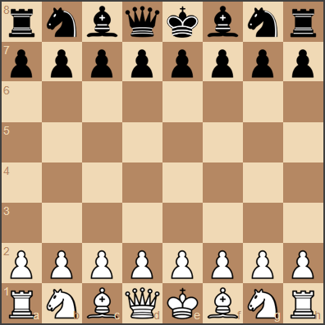
Is there another way?
Html Canvas
No consistency
No control
Security issues
Fixed templates
Complete control
No flexibility
Update Treadmill
????

Slide 64
Demo

Slide 65

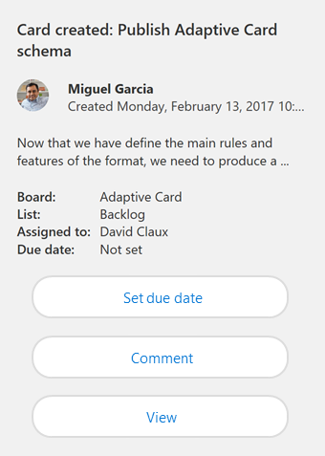
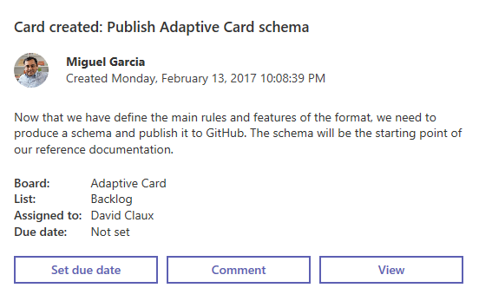
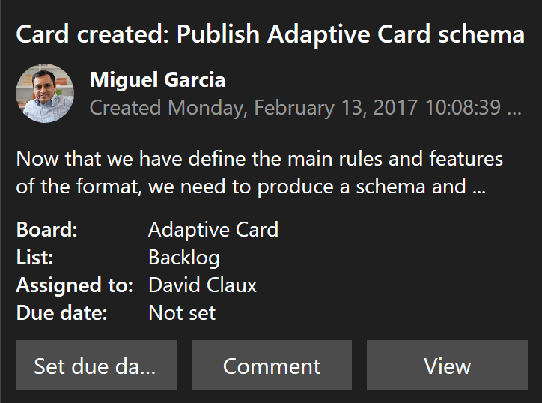
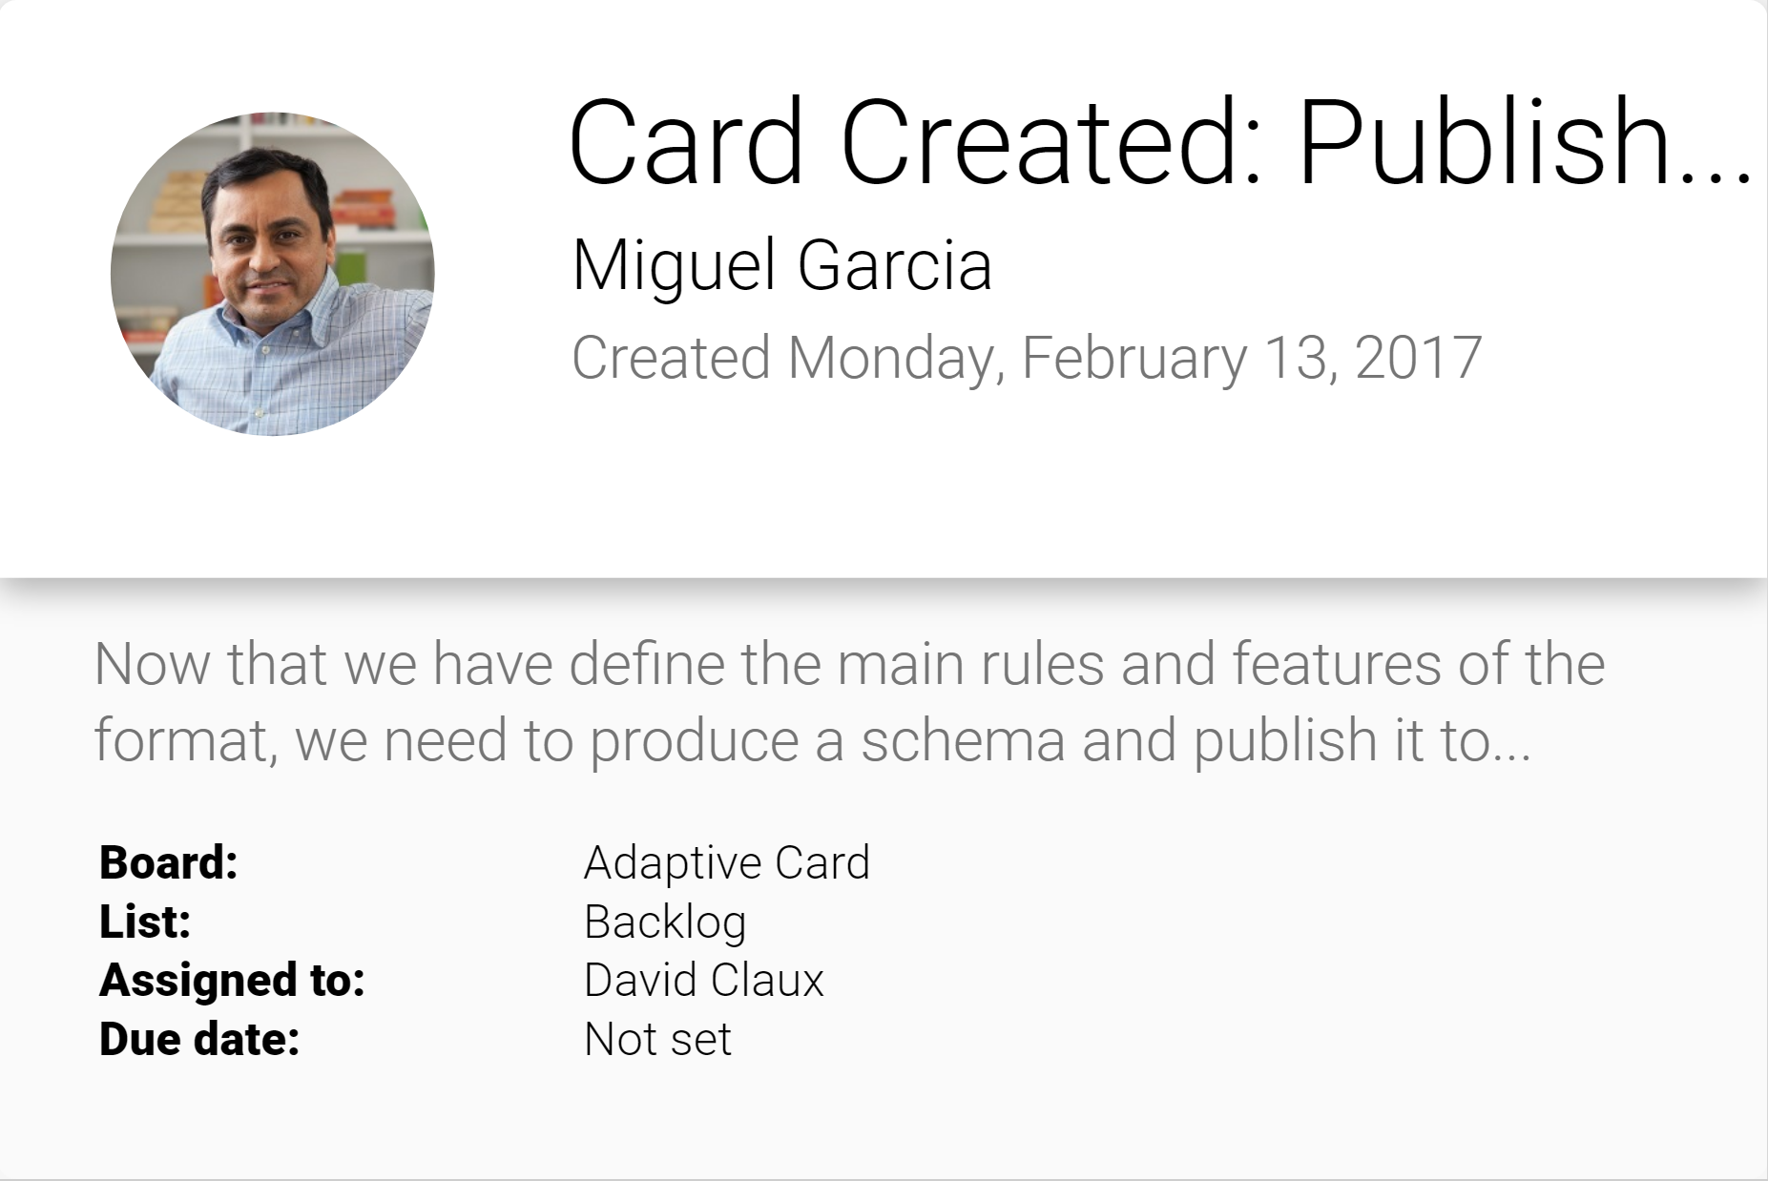
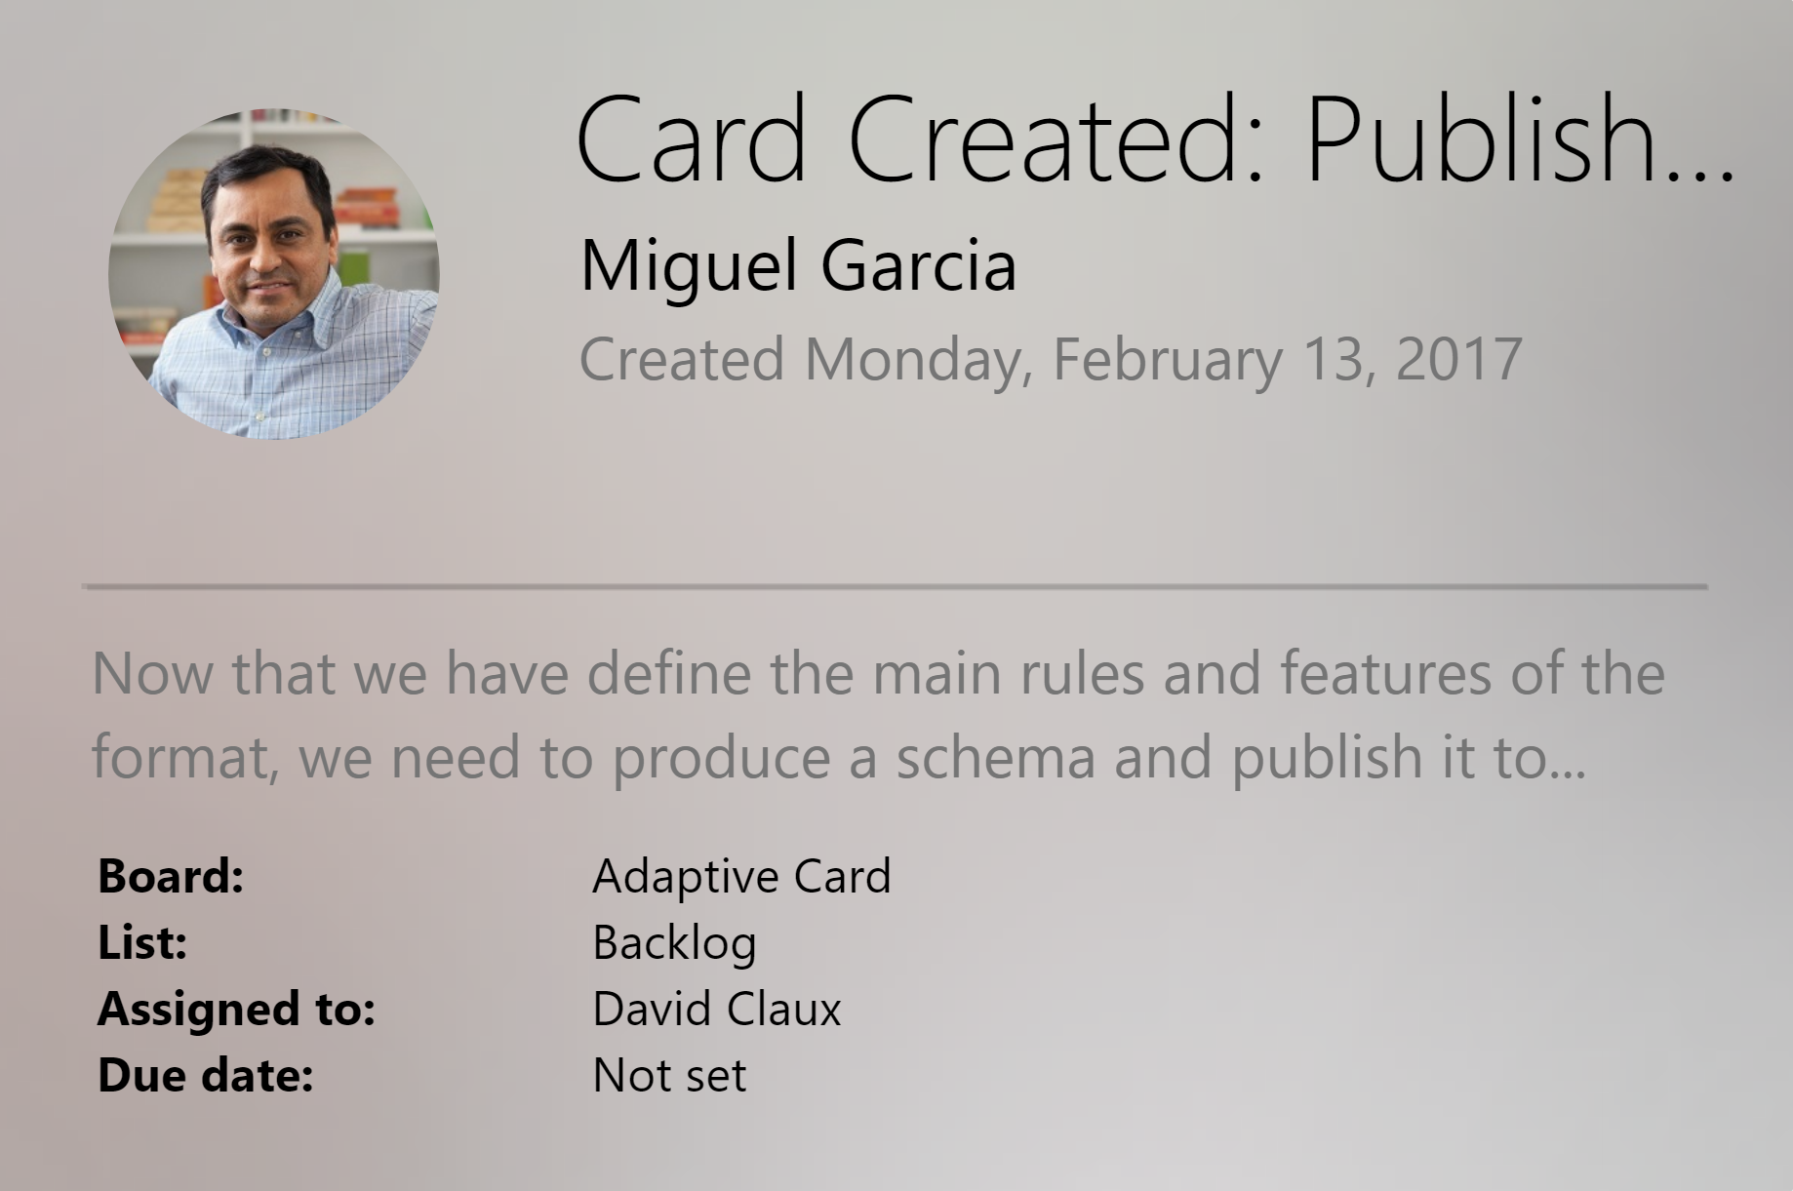
Adaptive Cards
Open FRAMEWORK
Multiple canvases
Notifications
Microsoft Teams
Skype
Android
iOS

Slide 66
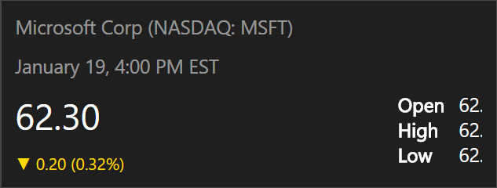
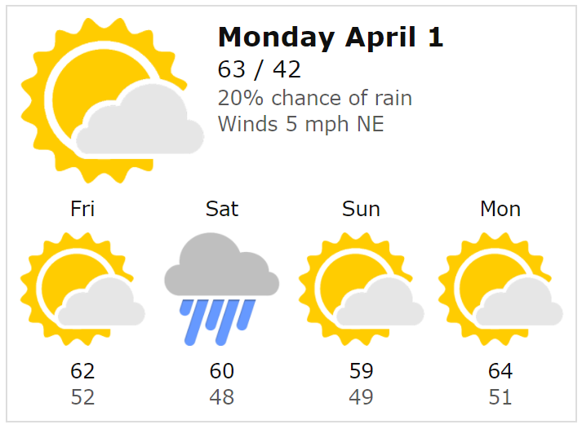
Filling the middle ground
Fixed templates
Complete control
No flexibility
Update Treadmill
Adaptive Cards
Flexible enough payload to cover 80% of needs
Host maintains strong control over style and security
Html Canvas
No consistency
No control
Security issues

Slide 67
Adaptive Cards
Sit between fixed templates and custom layout like HTML/XAML
Automatically adapt to the Host UX and brand guidelines
Low cost -targeted at the long tail
Purely declarative, no code

Slide 68
Demo
Building Adaptive Cards

Slide 69
Adaptive Cards
Rich schema for to layout content
Actions to open URLs, show other cards, etc
Input to gather information from users
Speech enabled from day-one

Slide 70
Tooling
Interactive Visualizer
Schema Explorer
VS Code Previewer

Slide 71
Adaptive Cards Ecosystem

Slide 72
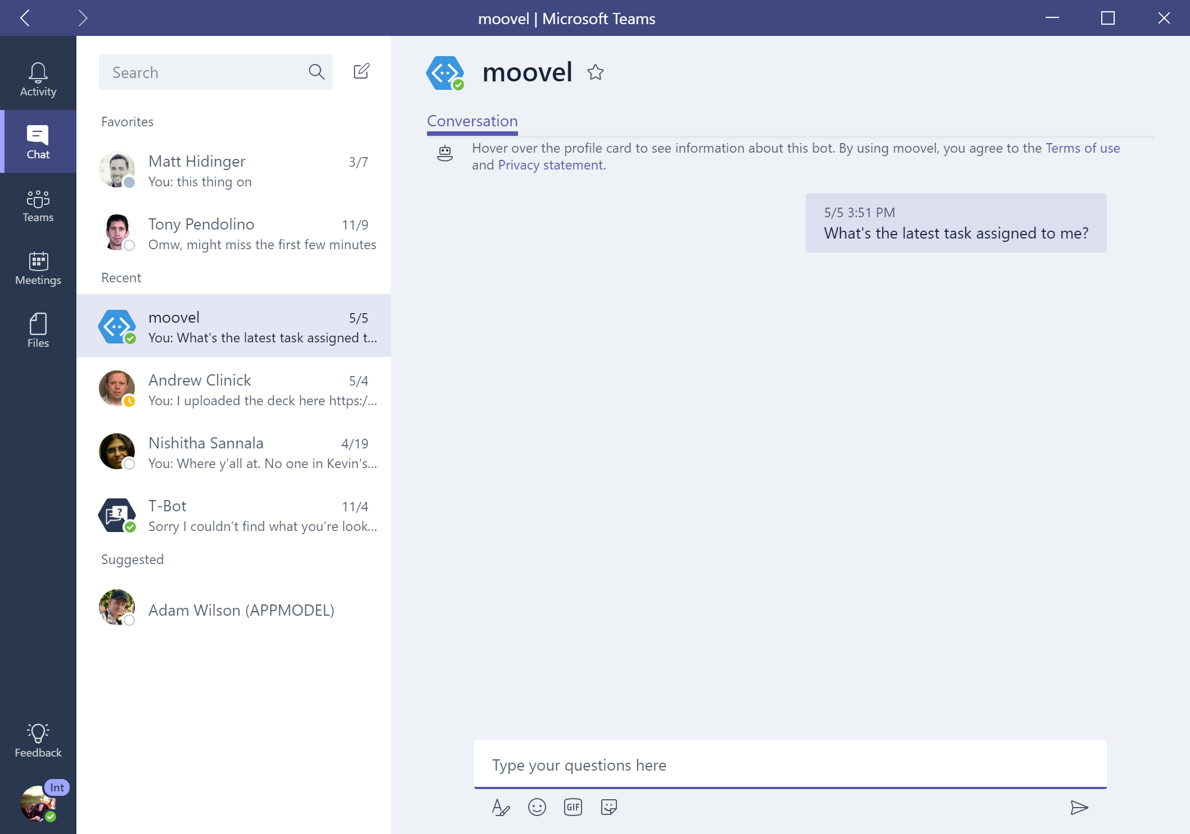

contoso
contoso
Card created: Publish Schema
Miguel Garcia
Created Monday, February 13, 2017
Now that we have define the main rules and features of the format, we need to produce a schema and publish it to GitHub. The…
Board:
Adaptive Card
List:
Backlog
Assigned To:
David Claux
Assigned To:
Not Set

Slide 73

BOT FRAMEWORK
Bot message
Microsoft Teams
Card
Card created: Publish Schema
Miguel Garcia
Created Monday, February 13, 2017
Now that we have define the main rules and features of the format, we need to produce a schema and publish it to GitHub. The…
Board:
Adaptive Card
List:
Backlog
Assigned To:
David Claux
Assigned To:
Not Set

Slide 74
BOT FRAMEWORK
Bot message
Microsoft Teams
Card
Routing info
Channel data
attachments
Card created: Publish Schema
Miguel Garcia
Created Monday, February 13, 2017
Now that we have define the main rules and features of the format, we need to produce a schema and publish it to GitHub. The…
Board:
Adaptive Card
List:
Backlog
Assigned To:
David Claux
Assigned To:
Not Set

Slide 75
Windows
activity
Microsoft Teams
Card
Metadata
URI
Visual
Card created: Publish Schema
Miguel Garcia
Created Monday, February 13, 2017
Now that we have define the main rules and features of the format, we need to produce a schema and publish it to GitHub. The…
Board:
Adaptive Card
List:
Backlog
Assigned To:
David Claux
Assigned To:
Not Set

Slide 76
activity
Microsoft Teams
Card
Card created: Publish Schema
Miguel Garcia
Created Monday, February 13, 2017
Now that we have define the main rules and features of the format, we need to produce a schema and publish it to GitHub. The…
Board:
Adaptive Card
List:
Backlog
Assigned To:
David Claux
Assigned To:
Not Set

Slide 77
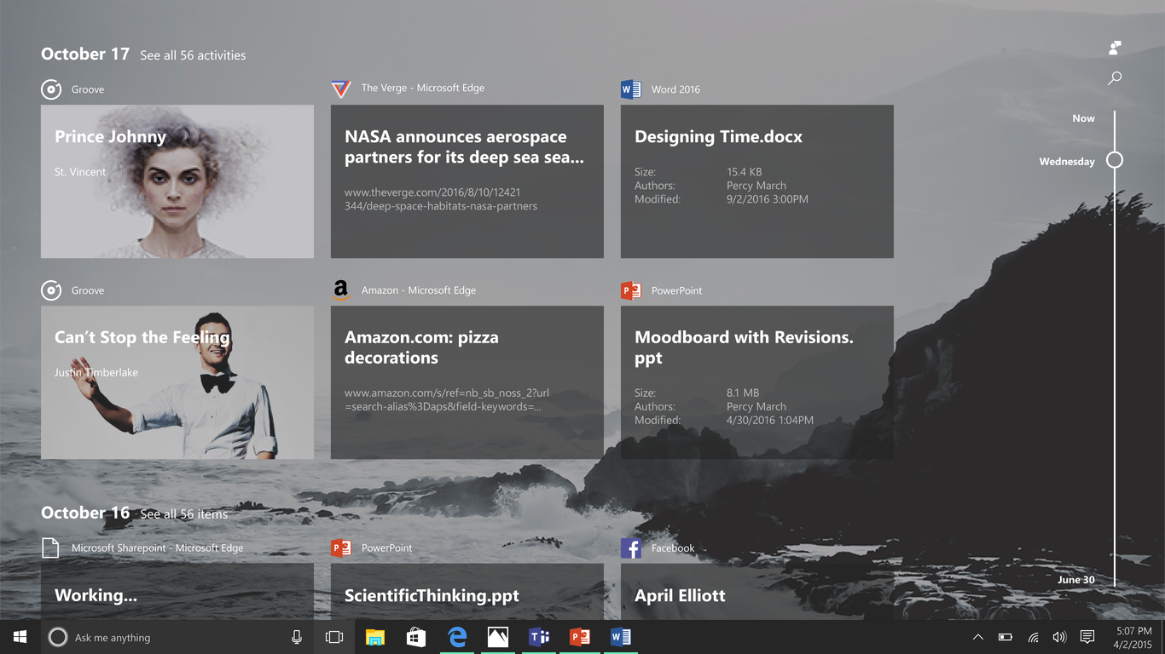
activity
Microsoft Teams
Card
Card created: Publish Schema
Miguel Garcia
Created Monday, February 13, 2017
Now that we have define the main rules and features of the format, we need to produce a schema and publish it to GitHub. The…
Board:
Adaptive Card
List:
Backlog
Assigned To:
David Claux
Assigned To:
Not Set

Slide 78






MSN Weather
Host Configuration
Adaptive Card

Slide 79
Platform Status
Android
Alpha
Beta
HTML
iOS
WPF
UWP
Xamarin Forms

Slide 80
Adaptive Cards
Sit between fixed templates and custom layout like HTML/XAML
Automatically adapt to the Host UX and brand guidelines
Low cost -targeted at the long tail
Purely declarative, no code

Slide 81
Making Adaptive Cards
var card = new AdaptiveCard();
// Specify speech for the card.
card.Speak = "<s>Your meeting about \"Adaptive Card design session\"<break strength='weak'/> is starting at 12:30pm</s><s>Do you want to review docs?</s>";
// Add text to the card.
card.Body.Add(new TextBlock()
{
Text = "Adaptive Card design session",
Size = TextSize.Large,
Weight = TextWeight.Bolder
});
// Add an action (button)
card.Actions.Add(new HttpAction()
{
Url = "http://foo.com/documents/194766162",
Title = “Show me docs"
});

Slide 82
Making Adaptive Cards
var replyToConversation = activity.CreateReply("Should go to conversation");
replyToConversation.Attachments = new List<Attachment>();
// Create the attachment with the card
Attachment attachment = new Attachment()
{
ContentType = AdaptiveCard.ContentType,
Content = card
};
// Send it
replyToConversation.Attachments.Add(attachment);
await connector.Conversations.SendToConversationAsync(replyToConversation);

Slide 83
Events and Back channel
Sometimes we need custom actions in the browser
Browser has access to resources bot code doesn’t
Sharepoint
Sometimes we need custom actions in code
Example dump all logs

Slide 84
Client to Bot
// Handle an incoming event message
if (activity.Type == ActivityTypes.Event && activity.Name == "userInfo")
{
// Get the data (in this case userName
var userName = activity.Value.ToString();
//....
}

Slide 85
Bot to Client
public async Task<HttpResponseMessage> Post([FromBody]Activity activity)
{
//Need connector to reply
var connector = new ConnectorClient(new Uri(activity.ServiceUrl));
var reply = activity.CreateReply();
reply.Type = ActivityTypes.Event;
reply.Name = "getUserInfo";
reply.Value = $"any other custom data";
await connector.Conversations.ReplyToActivityAsync(reply);
}

Slide 86
Custom DirectLine
//Hosting web control directly
<script src="~/js/botchat.js"></script>
<script>
//initialize bot control
//….
//specify action for event
botConnection.activity$
.filter(activity => activity.type === "event"
&& activity.name === "forceOffline")
.subscribe(activity => forceOffline())
//event code
const forceOffline = () => { //magical dom stuff }
</script>

Slide 87

You talking to me? Why NLP is Making Bots the New Apps.
@Daniel Egan Technical Evangelist - Microsoft

Slide 88
Hands On LAB
Exercise 4 – Carousels Cards and Adaptive Cards

Slide 89
Intent Dialogs
Using Natural Language Processing

Slide 90
Why Bots are like text based Adventure Games

Slide 91


Slide 92
NLP To the Rescue

Slide 93
Why is NLP so hard?

Slide 94
“I saw a man on a hill with a telescope.”
Simple statement?
There’s a man on a hill, and I’m watching him with my telescope.
There’s a man on a hill, who I’m seeing, and he has a telescope.
There’s a man, and he’s on a hill that also has a telescope on it.
I’m on a hill, and I saw a man using a telescope.
Notes:
http://blog.algorithmia.com/introduction-natural-language-processing-nlp/
https://www.youtube.com/watch?v=8S3qHHUKqYk
Tons of stuff here : http://blog.algorithmia.com/introduction-natural-language-processing-nlp/
Human generated language.
spam detection
Millennial speak
On fleek
Bae
Dabbing
Yolo
Throwing Shade

Slide 95
Think about a bot used to answer customers questions about laptops and accessories.
Has my order number 15489 been shipped yet?
How fast is the Surface 3?
Do you sell Acer Laptops and drives?
What kind of a display is on Surface 4
Notes:
http://blog.algorithmia.com/introduction-natural-language-processing-nlp/
https://www.youtube.com/watch?v=8S3qHHUKqYk
Tons of stuff here : http://blog.algorithmia.com/introduction-natural-language-processing-nlp/
Human generated language.
spam detection
Millennial speak
On fleek
Bae
Dabbing
Yolo
Throwing Shade

Slide 96


Slide 97
Determine Intent
Define Entities

Slide 98


How LUIS.ai works
LUIS.ai
Language Understanding Intelligence Service
Identify entities and intents of messages
Train through GUI or programmatically
Built in LUIS intent handling in bot framework

Slide 99
Intent Recognizers
What they said
What they meant
Intent
Recognizer
Implements IIntent Interface

Slide 100
New bot developers tend to abuse NLP
A bot with a single dialog using 100 LUIS intents is a bad design:
One question
100 LUIS intents, * 100 different utterances per intent = 10000 different things users may say (plus the other 90000 possibilities you didn’t predict)
100 different things your bot can do
Users will only guess 3 or so
So you just wasted 97% of your code
Hello user! How can I help you?

Slide 101
Users never say things the way you expect
As you model your NLP, make sure you’re being realistic

Slide 102
New bot developers tend to abuse NLP
So instead:
Hello user! How can I help you?
What events are you interested in?
What music would you like? (by the way, next time you could just type “I’m looking for a song named xyz” and I will know what to do)
Events
Music
Stages
Comedy
Amenities
Film
Laser Dome
Spectacles
Theater
Guide the user
Save time
Help the user discover what your bot can do

Slide 103

Directed or Non-Directed

Slide 104
Non -Directed
Directed

Slide 105
Non -Directed
Directed

Slide 106
How do I sign up?
How can you help me
Is there a warrantee?
What is a reserve price?
How long does the battery last?
I'm looking for cameras
Show me some shoes.
General Questions
Product Search
Product Details

Slide 107
Hands On LAB
Exercise 5 – Using Intent Dialogs

Slide 108
Adding Cognitive Services

Slide 109
Microsoft Cognitive Services
VISION
SPEECH
LANGUAGE
KNOWLEDGE
SEARCH
Computer Vision
Custom Speech Service (formerly CRIS)
Bing Spell Check
Academic Knowledge
Bing Autosuggest
Emotion
Speaker Recognition
Language Understanding
Entity Linking
Bing Image Search
Content Moderator
Speech
Linguistic Analysis
Knowledge Exploration
Bing News Search
Face
Translator
Text Analytics
Recommendations
Bing Video Search
Video
Web Language Model
QnA Maker
Bing Web Search

Slide 110

Powerful models
Cognitive Services models are trained using the same deep learning and machine learning techniques that power many products across Microsoft

Slide 111

Easy to use
Microsoft Cognitive Services allows you to focus on your application by easily including these services across platforms through simple REST APIs

Slide 112
Vision
Computers that see

Slide 113

Analyze Image – Example
Type of Image:
Clip Art Type 0 Non-clipart
Line Drawing Type 0 Non-Line Drawing
Black & White Image False
Content of Image:
Categories [{ “name”: “people_swimming”, “score”: 0.099609375 }]
Adult Content False
Adult Score 0.18533889949321747
Faces [{ “age”: 27, “gender”: “Male”, “faceRectangle”: {“left”: 472, “top”: 258, “width”: 199, “height”: 199}}]
Image Colors:
Dominant Color Background White
Dominant Color Foreground Grey
Dominant Colors White
Accent Color

Slide 114


Analyze Image – Example
Categories v0: [{ “name”: “animal”, “score”: 0.9765625 }]
V1: [{ "name": "grass", "confidence": 0.9999992847442627 },
{ "name": "outdoor", "confidence": 0.9999072551727295 },
{ "name": "cow", "confidence": 0.99954754114151 },
{ "name": "field", "confidence": 0.9976195693016052 },
{ "name": "brown", "confidence": 0.988935649394989 },
{ "name": "animal", "confidence": 0.97904372215271 },
{ "name": "standing", "confidence": 0.9632768630981445 },
{ "name": "mammal", "confidence": 0.9366017580032349, "hint": "animal" },
{ "name": "wire", "confidence": 0.8946959376335144 },
{ "name": "green", "confidence": 0.8844101428985596 },
{ "name": "pasture", "confidence": 0.8332059383392334 },
{ "name": "bovine", "confidence": 0.5618471503257751, "hint": "animal" },
{ "name": "grassy", "confidence": 0.48627158999443054 },
{ "name": "lush", "confidence": 0.1874018907546997 },
{ "name": "staring", "confidence": 0.165890634059906 }]
Describe
0.975 "a brown cow standing on top of a lush green field“
0.974 “a cow standing on top of a lush green field”
0.965 “a large brown cow standing on top of a lush green field”

Slide 115

Wackcoon

Slide 116



Wackcoon
Content of Image:
Categories v0: [{ “name”: “animal”, “score”: 0.9765625 }]
V1: [{ "name": "grass", "confidence": 0.9999992847442627 },
{ "name": "outdoor", "confidence": 0.9999072551727295 },
{ "name": "cat", "confidence": 0.99954754114151 },
{ "name": "raccoon", "confidence": 0.9976195693016052 },
{ "name": "grey", "confidence": 0.988935649394989 },
{ "name": "animal", "confidence": 0.97904372215271 },
{ "name": "standing", "confidence": 0.9632768630981445 },
{ "name": "mammal", "confidence": 0.9366017580032349, "hint": "animal" },
{ "name": "aquarium", "confidence": 0.8946959376335144 },
{ "name": "green", "confidence": 0.8844101428985596 },
{ "name": "grass", "confidence": 0.8332059383392334 },
{ "name": "water", "confidence": 0.5618471503257751 },
{ "name": "grassy", "confidence": 0.48627158999443054 },
{ "name": "lush", "confidence": 0.1874018907546997 },
{ "name": "staring", "confidence": 0.165890634059906 }]

Slide 117
Demo
microsoft.com/cognitive
Start coding
A simple bot using the vision API
We will go deeper about the BotFramework Later

Slide 118

Face APIs Detection
Verification
Grouping
Identification

Slide 119


Face API – Detection
Detection Result:
JSON:
[
{
"faceRectangle": {
"width": 109,
"height": 109,
"left": 62,
"top": 62
},
"attributes": {
"age": 41,
"gender": "male",
"headPose": {
"roll": "2.9",
"yaw": "-1.3",
"pitch": "0.0"
}
"faceLandmarks": {
"pupilLeft": {
"x": "93.6",
"y": "88.2"
},
"pupilRight": {
"x": "138.4",
"y": "91.7"
},
...
DETECTION
ATTRIBUTES
INPUT IMAGE
FACIAL RECTANGLE + LANDMARKS

Slide 120
Face API – Detection
Detection Result:
JSON:
[
{
"faceRectangle": {
"width": 109,
"height": 109,
"left": 62,
"top": 62
},
"attributes": {
"age": 31,
"gender": "male",
"headPose": {
"roll": "2.9",
"yaw": "-1.3",
"pitch": "0.0"
}
"faceLandmarks": {
"pupilLeft": {
"x": "93.6",
"y": "88.2"
},
"pupilRight": {
"x": "138.4",
"y": "91.7"
},
...
.
.
.
.
.
.
.
.
.
.
.
.
.
.
.
.
.
.
.
.
.
.
.
.
.
.

Slide 121

Face API – Verification
Given two faces, determine whether they are the same person
Verification Result:
JSON:
[
{
"isIdentical":false,
"confidence":0.01
}
]
.
.
.
.
.
.
.
.
.
.
.
.
.
.

Slide 122
Demo
microsoft.com/cognitive
Start coding
Lets see the online API

Slide 123
Publishing your Bot

Slide 124
Extras
Scorable Dialogs, Ngrok, QnA Maker ..

Slide 125

ngrok

Slide 126


Slide 127


In Cloud
BotFramework

Slide 128
Additional Materials
https://docs.botframework.com/ - Bot Framework Docs
https://github.com/pveller/ecommerce-chatbot - Node – Implements IIntentInterface
https://github.com/Microsoft/BotBuilder - SDK’s has a samples folder
https://github.com/Microsoft/BotBuilder-Samples - Different Samples (Skype, Facebook, etc.)
https://www.luis.ai/Help - Training videos and HOL for LUIS
https://docs.botframework.com/en-us/tools/bot-framework-emulator/ Emulator download
http://aka.ms/bf-bc-vstemplate C# Bot Template
https://ngrok.com - Ngrok

